Slide 1
Traversing binary trees with exactly zero stacks
CMSC 420

Slide 2
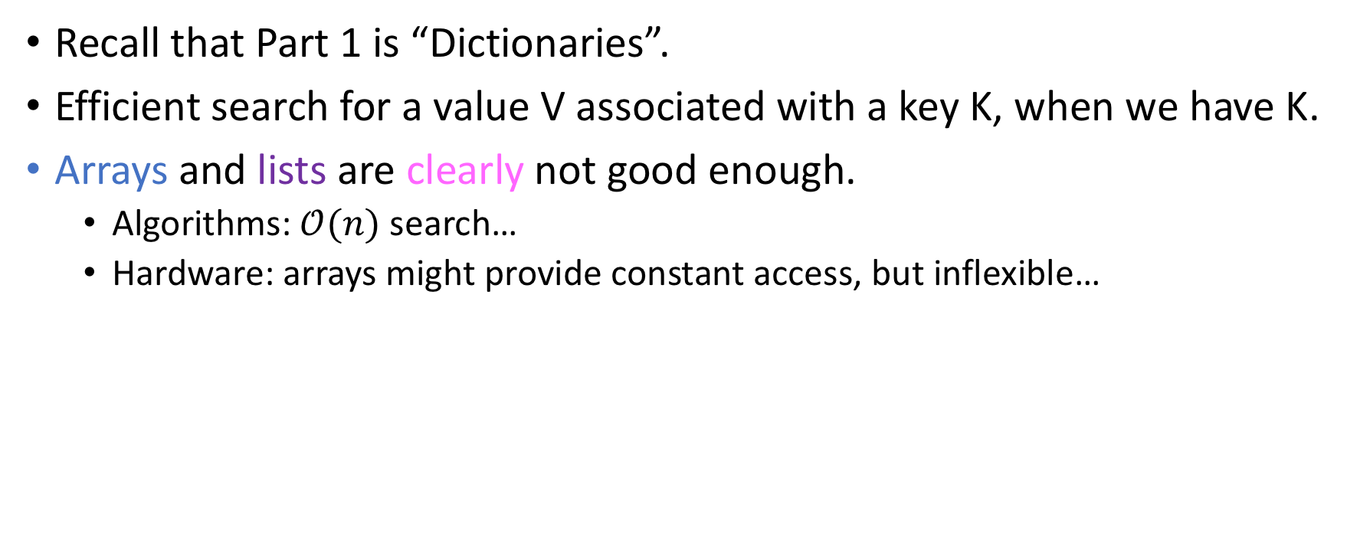
The notion of a dictionary
Recall that Part 1 is “Dictionaries”.
Efficient search for a value V associated with a key K, when we have K.
Arrays and lists are clearly not good enough.
Algorithms: $𝒪(n)$ search…
Hardware: arrays might provide constant access, but inflexible…

Slide 3
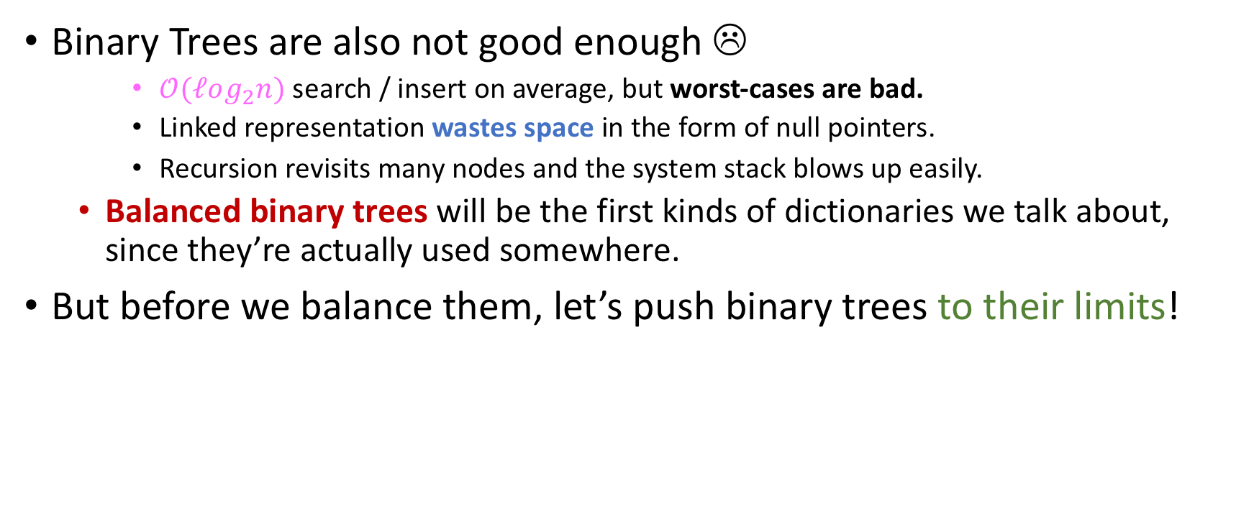
Binary trees as dictionaries
Binary Trees are also not good enough ☹
$𝒪(ℓog_{2}n)$ search / insert on average, but worst-cases are bad.
Linked representation wastes space in the form of null pointers.
Recursion revisits many nodes and the system stack blows up easily.
Balanced binary trees will be the first kinds of dictionaries we talk about, since they’re actually used somewhere.
But before we balance them, let’s push binary trees to their limits!

Slide 4
Let’s write some code… on paper!
Write down a recursive implementation of inorder traversal in Java. You have a max of 5 minutes.
Be as detailed as you can. Do many iterations if necessary!
Ask me for paper if you need it.
Berate me if I you need it and I forgot it.

Slide 5
Grading Key
You will grade your partner’s submission using the following key:
Criterion | Example questions to ask | Grading Percentage
Algorithmic Correctness | Is the recursion applied correctly? Does the code print out values when it should? | 45%
Runtime error-free | Is the code prone to a NullPointerException? What about a StackOverflowException? | 25%
Elegance | Is the code readable? Any arguments that we could avoid? Generally; could this have been attained with 2/3 rds or ½ of the code? | 20%
Compile error-free | If I typed this in as – is and ran javac on it, would it compile? | 10%

Slide 6
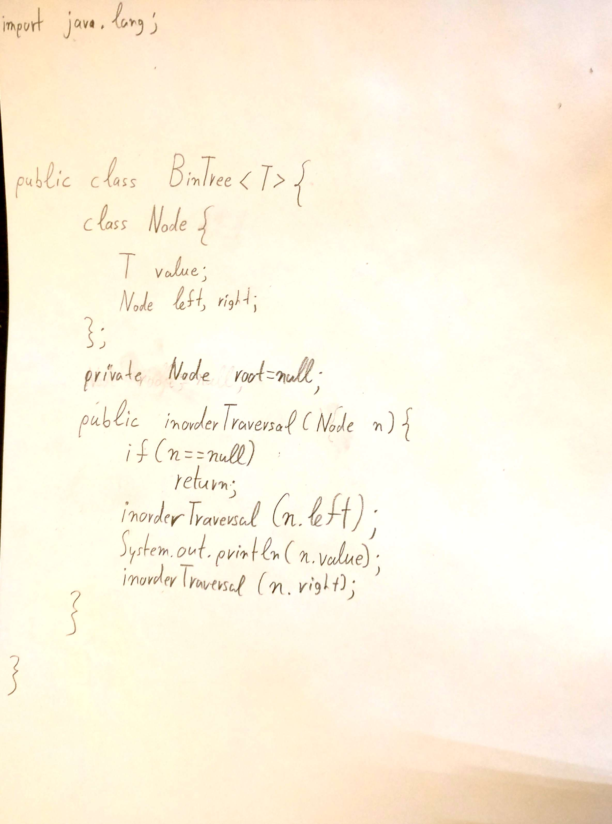
Jason’s Solution

Slide 7
Jason’s Solution
Grade? Be honest!

Slide 8
Jason’s Solution
Grade? Be honest!
Where’s the return type? This won’t compile…
(at least -5%)

Slide 9
Jason’s Solution
Grade? Be honest!
You can also make inorderTraversal an instance method of BinTree.Node, in order to avoid the Node argument
Where’s the return type? This won’t compile…

Slide 10
A harder question
Now, instead of using the system’s stack, let’s use our own!
In no more than 5 minutes, write Java code that uses your own Stack to do inorder traversal in a binary tree!
Then, grade it as before!

Slide 11
A harder question
Now, instead of using the system’s stack, let’s use our own!
In no more than 5 minutes, write Java code that uses your own Stack to do inorder traversal in a binary tree!
Then, grade it as before!
Criterion | Example questions to ask | Grading Percentage
Algorithmic Correctness | Is the recursion applied correctly? Does the code print out values when it should? | 45%
Runtime error-free | Is the code prone to a NullPointerException? What about a StackOverflowException? | 25%
Elegance | Is the code readable? Any arguments that we could avoid? Generally; could this have been attained with 2/3 rds or ½ of the code? | 20%
Compile error-free | If I typed this in as – is and ran javac on it, would it compile? | 10%

Slide 12

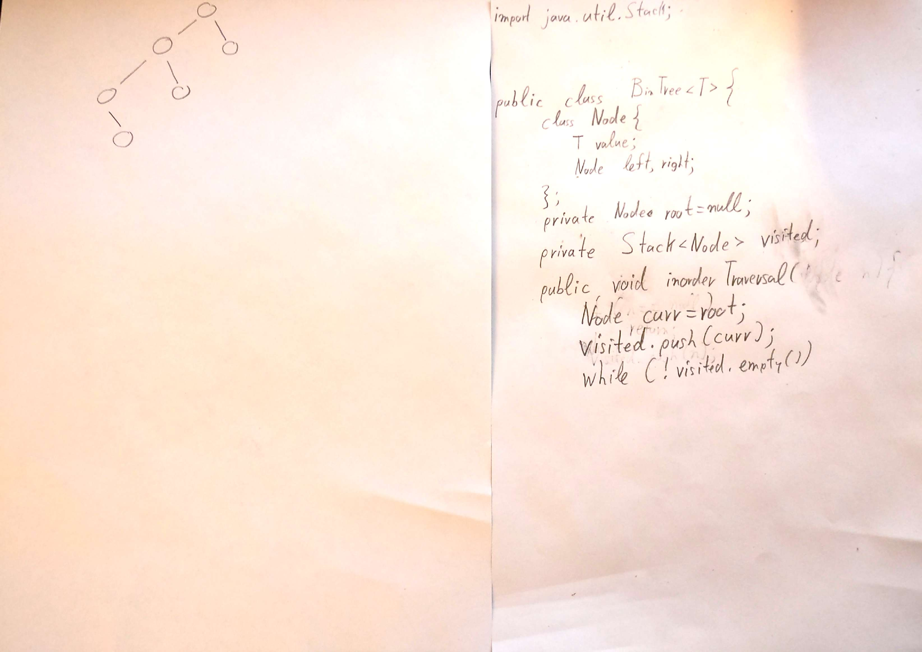



Jason’s Solution

Slide 13
A solution
public inorderTraversalWithStack(){
Stack<Node> s = new Stack<Node>(); // Important that we make a stack of Nodes, note of values
Node p = root;
while(!s.empty() || p != null){ // What’s the utility of the 2nd constraint?
if(p == null){ // This means that we were reached by some ancestral node.
p = s.pop(); // Visit said ancestral node,
print(p.value);
p = p.right; // and see if there’s anything on its right subtree.
} else { // So we are actually a living, breathing child of our parent.
s.push(p); // We should record our presence
p = p.left; // And see if there’s anything on the left to investigate
}
}
}

Slide 14
Vote!
We just compared two different ways to do inorder traversal in a binary tree.
Which one is the fastest, and why?
Recursive (System’s stack)
Iterative (Own stack)
They are both about the same.

Slide 15
Vote!
We just compared two different ways to do inorder traversal in a binary tree.
Which one is the fastest, and why?
Wayyyyy more than just a reference is pushed onto the system’s stack…
Program Counter (Instruction Pointer)
Local variables
…
Recursive (System’s stack)
Iterative (Own stack)
They are both about the same.

Slide 16

But how bad is it really?
It’s actually pretty bad. ☹
Especially in the JVM.
Let’s have a look at a Java demo where we generate the count for a linked list in 3 different ways.
In a classic iterative fashion.
Using our own stack.
Using recursion.

Slide 17
Another exercise!
Take a max of 5 minutes to write a non-recursive Binary Search Tree insertion!

Slide 18
Another exercise!
Take a max of 5 minutes to write a non-recursive Binary Search Tree insertion!
Afterwards, swap papers and grade using our familiar rubric:
Criterion | Example questions to ask | Grading Percentage
Algorithmic Correctness | Is the recursion applied correctly? Does the code print out values when it should? | 45%
Runtime error-free | Is the code prone to a NullPointerException? What about a StackOverflowException? | 25%
Elegance | Is the code readable? Any arguments that we could avoid? Generally; could this have been attained with 2/3 rds or ½ of the code? | 20%
Compile error-free | If I typed this in as – is and ran javac on it, would it compile? | 10%

Slide 19
Demo time!

Slide 20
Take-home message #1
When possible, we need to avoid recursion.
The system’s stack is very limited by the OS.
Replace with:
Using your own stack (inelegant, but much faster!)
Refactoring the code such that it does tail recursion, which is optimized into iteration by a modern compiler.
The keyword @tailrec in Scala attempts to do that even when you don’t take care of it yourself.
An iterative piece of code that achieves the same thing (sometimes inelegant, but faster and much better in terms of memory).
Recall: bottom-up mergesort avoids system stack pushes, yet iteratively solves the same problem.

Slide 21
Vote!
Is it possible to traverse a tree without using a stack (ours, or the system’s) at all?
I have clearly not been paying any attention to the lecture since I came into class today, with particular (non-)emphasis to the title page of the slide deck that we are currently scanning.
Yes

Slide 22
Vote!
Is it possible to traverse a tree without using a stack (ours, or the system’s) at all?
I have clearly not been paying any attention to the lecture since I came into class today, with particular (non-)emphasis to the title page of the slide deck that we are currently scanning.
Yes

Slide 23
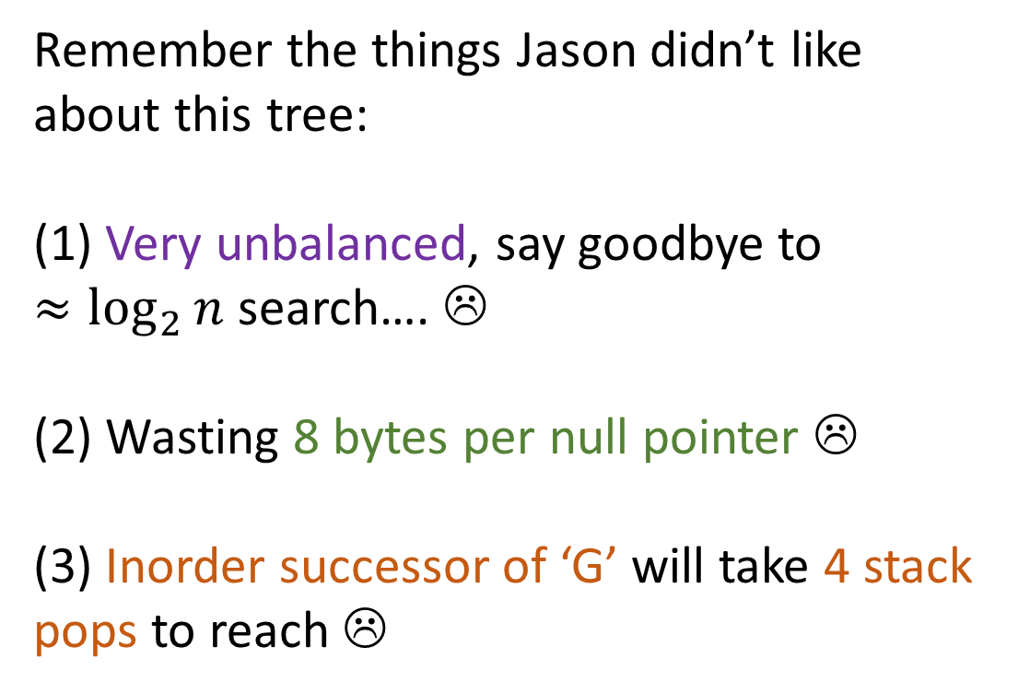
The hated tree
M
Remember the things Jason didn’t like about this tree: (1) Very unbalanced, say goodbye to $≈\log_{2}{n}$ search…. ☹
(2) Wasting 8 bytes per null pointer ☹
(3) Inorder successor of ‘G’ will take 4 stack pops to reach ☹
A
X
x
E
x
x
x
F
x
G
x
x

Slide 24

The hated tree
M
Remember the things Jason didn’t like about this tree: (1) Very unbalanced, say goodbye to $≈\log_{2}{n}$ search…. ☹
(2) Wasting 8 bytes per null pointer ☹
(3) Inorder successor of ‘G’ will take 4 stack pops to reach ☹
Let’s look at one idea that solves both of these problems in one fell swoop!
A
X
x
E
x
x
x
F
x
G
x
x

Slide 25
Our 1st solution: Threaded Trees
M
A
X
x
E
x
x
x
F
x
G
x
x

Slide 26
Our 1st solution: Threaded Trees
Exactly nothing to do with threads of an OS.
M
A
X
x
E
x
x
x
F
x
G
x
x

Slide 27
Threaded Trees
M
Key: Replace all null pointers with special pointers, called threads.
The right thread will point to the node’s inorder successor.
The left thread will point to the node’s inorder predecessor.
By convention, the side pointers that still point to NULL are also threads.
A predecessor or successor being null means that we are at the beginning or end of the sequence respectively.
A
X
x
E
x
F
G

Slide 28
Threaded Trees
M
Key: Replace most null pointers with special pointers, called threads.
Except for the “side” ones
By traversing a thread, you reach an inorder successor in constant time!
A
X
x
E
x
F
G

Slide 29
Threaded Trees
M
Key: Replace most null pointers with special pointers, called threads.
Except for the “side” ones
By traversing a thread, you reach an inorder successor in constant time!
But if you are not traversing a thread, but a classic pointer, you pay linear cost.
A
X
x
E
x
F
G

Slide 30
So, how do we do inorder traversal?
M
To do inorder traversal, I need to first be able to find the inorder successor of any given node!
A
X
x
E
x
F
G

Slide 31
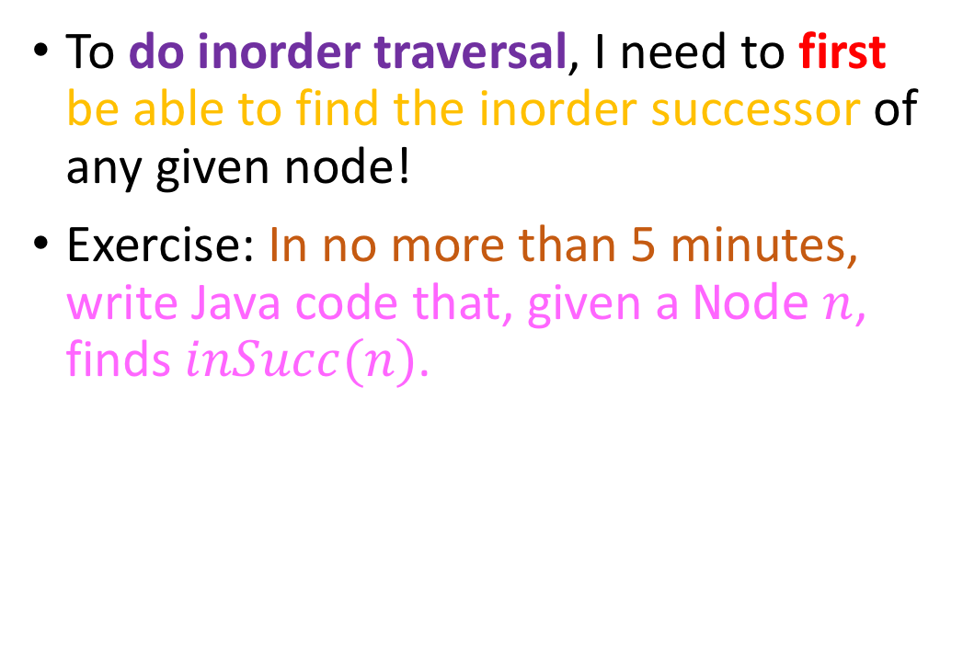
So, how do we do inorder traversal?
M
To do inorder traversal, I need to first be able to find the inorder successor of any given node!
Exercise: In no more than 5 minutes, write Java code that, given a Node $n$, finds $inSucc(n)$.
A
X
x
E
x
F
G
Notes:
Write down a simple Node class on your piece of paper.

Slide 32
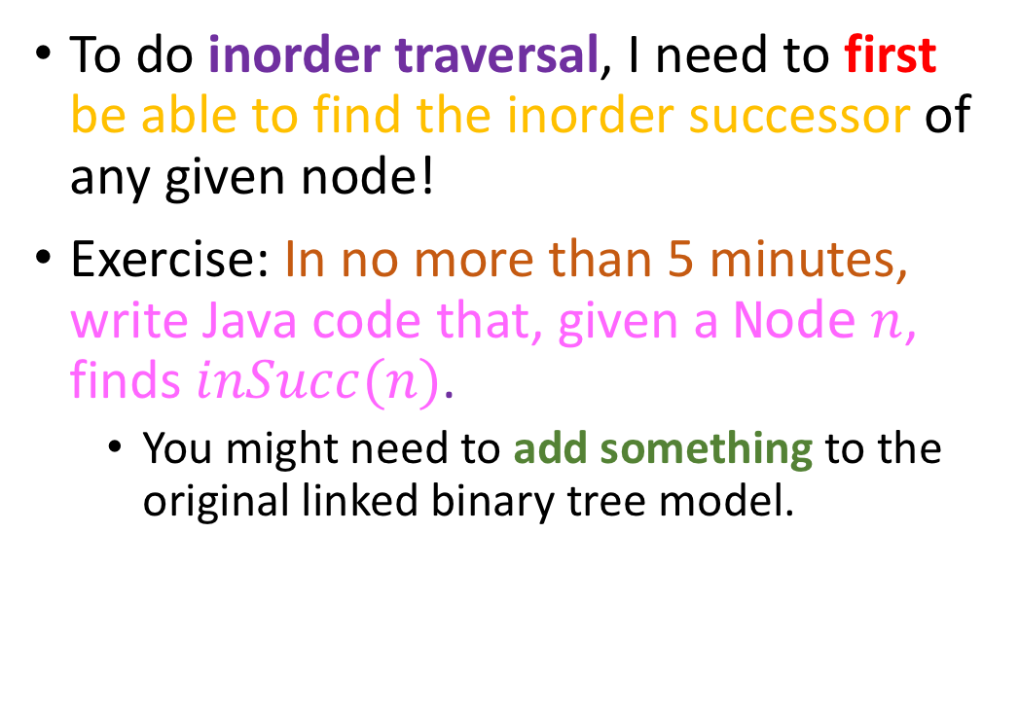
So, how do we do inorder traversal?
M
To do inorder traversal, I need to first be able to find the inorder successor of any given node!
Exercise: In no more than 5 minutes, write Java code that, given a Node $n$, finds $inSucc(n)$.
You might need to add something to the original linked binary tree model.
A
X
x
E
x
F
G

Slide 33
Finding the inorder successor
M
We need information about whether a pointer is a classic pointer or a thread!
A
X
x
E
x
F
G

Slide 34
Finding the inorder successor
M
We need information about whether a pointer is a classic pointer or a thread!
Easiest solution: one bit per link.
State: 1 for thread, 0 for link (or vice versa)
Call those bits lb, rb.
A
X
x
E
x
F
G

Slide 35
Finding the inorder successor
M
Node inSucc(Node n){
if(n.rb)
return n.right; // null or otherwise
else{ // Go right and then as far left // as you can
n = n.right;
while(!n.lb) // What does n.lb = 0 mean?
n=n.left;
return n;
}
}
A
X
x
E
x
F
G

Slide 36
Finding the inorder successor
M
Node inSucc(Node n){
else{ // Go right and then as far left // as you can
n = n.right;
return n;
}
}
if(n.rb)
return n.right; // thread
Constant
A
X
Linear
x
E
x
while(!n.lb) // What does n.lb = 0 mean?
n=n.left;
F
G

Slide 37
Finding the inorder successor
M
Node inSucc(Node n){
else{ // Go right and then as far left // as you can
n = n.right;
return n;
}
}
if(n.rb)
return n.right; // thread
Constant
A
X
Linear
x
E
x
while(!n.lb) // What does n.lb = 0 mean?
n=n.left;
F
G
So, let’s answer this question: Finding the inorder successor of a node in a threaded tree runs in…
Constant time
Linear time
Logarithmic time
Something else (what?)

Slide 38
Finding the inorder successor
M
Node inSucc(Node n){
else{ // Go right and then as far left // as you can
n = n.right;
return n;
}
}
if(n.rb)
return n.right; // thread
Constant
A
X
Linear
x
E
x
while(!n.lb) // What does n.lb = 0 mean?
n=n.left;
F
So, let’s answer this question: Finding the inorder successor of a node in a threaded tree runs in…
G
Amortized constant time!
Constant time
Linear time
Logarithmic time
Something else (what?)

Slide 39

Finding the inorder successor
M
Constant
Node inSucc(Node n){
else{ // Go right and then as far left // as you can
n = n.right;
return n;
}
}
if(n.rb)
return n.right; // thread
A
X
x
E
x
Linear
while(!n.lb) // What does n.lb = 0 mean?
n=n.left;
F
G
But hold on… best case constant, worst-case linear, how does that mean amortized constant?

Slide 40
Finding the inorder successor
M
Node inSucc(Node n){
if(n.right == null) return;
else{ // Go right and then as far left // as you can
n = n.right;
return n;
}
}
Constant
if(n.rb)
n = n.right; // thread
A
X
x
E
x
Linear
while(!n.lb) // What does n.lb = 0 mean?
n=n.left;
F
G
But hold on… best case constant, worst-case linear, how does that mean amortized constant?
Let’s present the full inorder traversal algo first and then we’ll talk about this in detail…

Slide 41

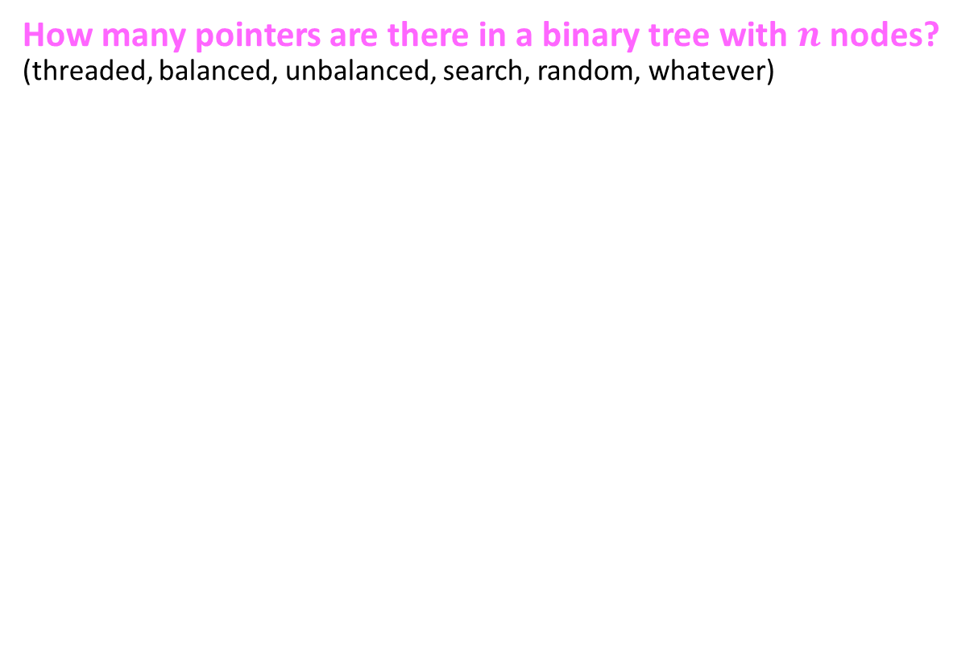
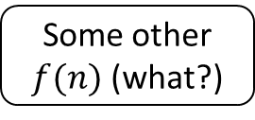
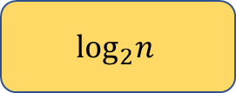

Question for you
M
How many pointers are there in a binary tree with $n$ nodes? (threaded, balanced, unbalanced, search, random, whatever)
A
X
$$n$$
$$2n$$
$$\log_{2}n{ }$$
Some other $f(n)$ (what?)
x
E
x
F
G

Slide 42
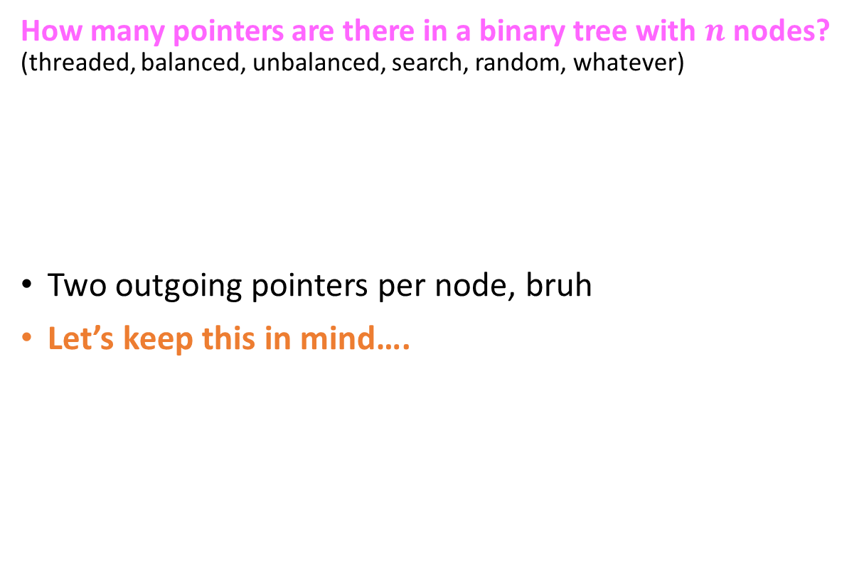
Question for you
M
How many pointers are there in a binary tree with $n$ nodes? (threaded, balanced, unbalanced, search, random, whatever)
Two outgoing pointers per node, bruh
Let’s keep this in mind….
A
X
$$n$$
$$2n$$
$$\log_{2}n{ }$$
Some other $f(n)$ (what?)
x
E
x
F
G

Slide 43
Inorder traversal in a threaded tree
M
static void inorderTraversal(ThreadedTree t){
Node n = t.getRoot();
while(n.getLeft() != null)
n = n.getLeft(); // Go as left as you can.
print(n.getValue());
while(n != null){
n = inSucc(n); // Call to our previous function
print(n.getValue());
}
}
A
X
x
E
x
F
G

Slide 44

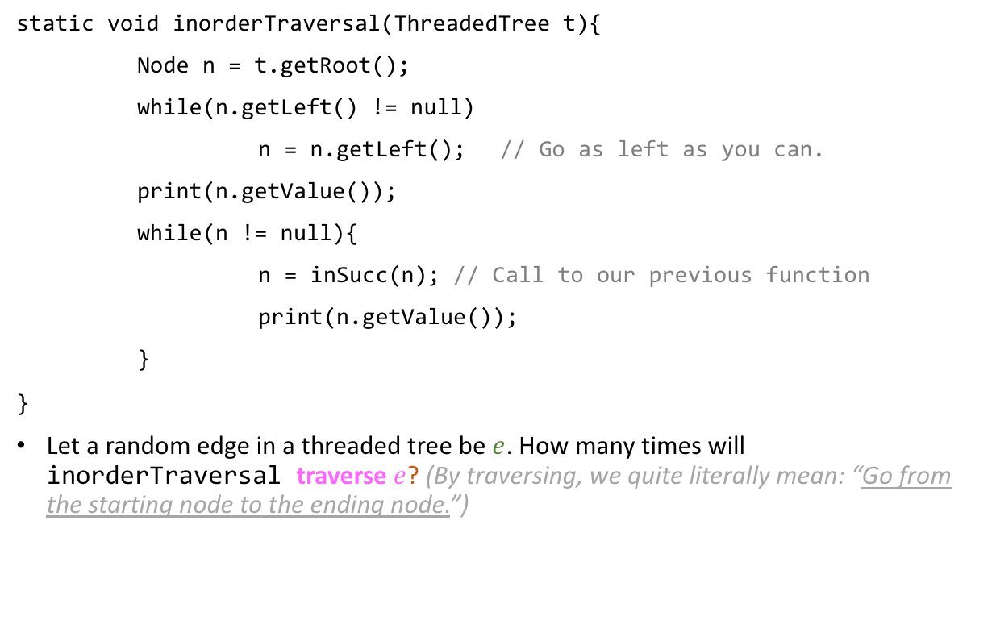
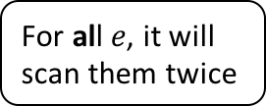

Inorder traversal in a threaded tree
M
static void inorderTraversal(ThreadedTree t){
Node n = t.getRoot();
while(n.getLeft() != null)
n = n.getLeft(); // Go as left as you can.
print(n.getValue());
while(n != null){
n = inSucc(n); // Call to our previous function
print(n.getValue());
}
}
Let a random edge in a threaded tree be $e$. How many times will inorderTraversal traverse $e$? (By traversing, we quite literally mean: “Go from the starting node to the ending node.”)
A
X
x
E
x
F
G
For some $e$, it won’t even visit them.
All of them exactly once
$$\text{For} \text{some} e\text{, }\text{it} \text{will} \text{scan} \text{them} \text{twice}$$
$$\text{For} \text{al}\text{l} e\text{, }\text{it} \text{will} \text{scan} \text{them} \text{twice}$$

Slide 45


Inorder traversal in a threaded tree
M
static void inorderTraversal(ThreadedTree t){
Node n = t.getRoot();
while(n.getLeft() != null)
n = n.getLeft(); // Go as left as you can.
print(n.getValue());
while(n != null){
n = inSucc(n); // Call to our previous function
print(n.getValue());
}
}
Let a random edge in a threaded tree be $e$. How many times will inorderTraversal traverse $e$? (By traversing, we quite literally mean: “Go from the starting node to the ending node.”)
A
X
x
E
x
F
G
For some $e$, it won’t even visit them.
All of them exactly once
$$\text{For} \text{some} e\text{, }\text{it} \text{will} \text{scan} \text{them} \text{twice}$$
$$\text{For} \text{al}\text{l} e\text{, }\text{it} \text{will} \text{scan} \text{them} \text{twice}$$

Slide 46
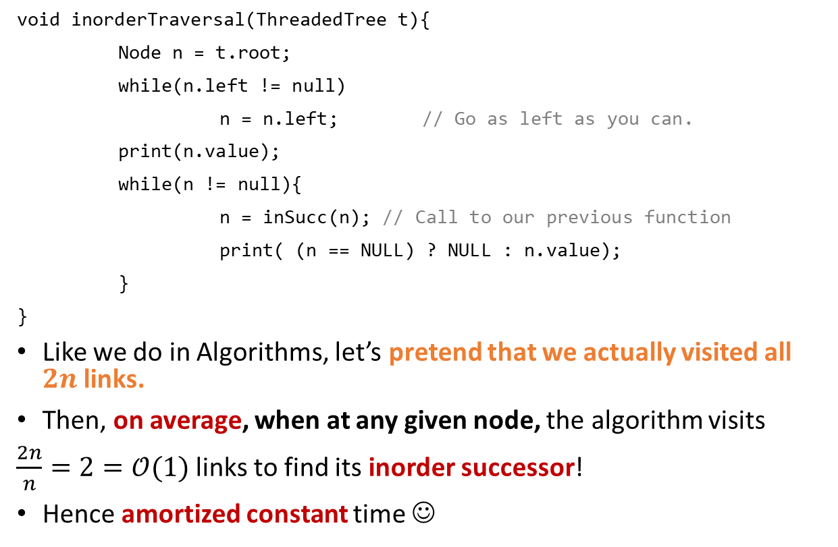
Inorder traversal in a threaded tree
M
void inorderTraversal(ThreadedTree t){
Node n = t.root;
while(n.left != null)
n = n.left; // Go as left as you can.
print(n.value);
while(n != null){
n = inSucc(n); // Call to our previous function
print( (n == NULL) ? NULL : n.value);
}
}
Like we do in Algorithms, let’s pretend that we actually visited all $2n$ links.
Then, on average, when at any given node, the algorithm visits
$\frac{2n}{n}=2=𝒪(1)$ links to find its inorder successor!
Hence amortized constant time ☺
A
X
x
E
x
F
G

Slide 47

I am unconvinced!
Now hold on… does this analysis prove that searching a linked list is amortized constant, since best-case search is constant and worst-case linear ? This can’t be true!

Slide 48
I am unconvinced!
Now hold on… does this analysis prove that searching a linked list is amortized constant, since best-case search is constant and worst-case linear ? This can’t be true!
Let’s see what amortized analysis of the search() operation on a (singly) linked list reveals…

Slide 49

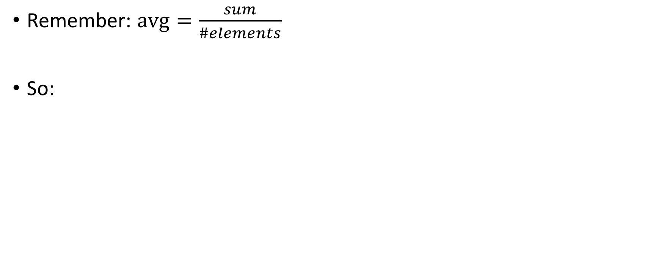
Searching a linked list
Remember: $avg=\frac{sum}{\#elements}$
So:

Slide 50
Searching a linked list
Remember: $avg=\frac{sum}{\#elements}$
So:
ptr
G
A
X
D

Slide 51
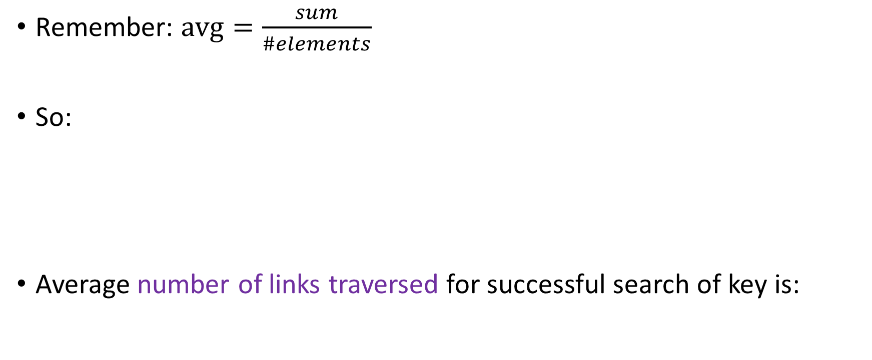
Searching a linked list
Remember: $avg=\frac{sum}{\#elements}$
So:
Average number of links traversed for successful search of key is:
ptr
G
A
X
D

Slide 52
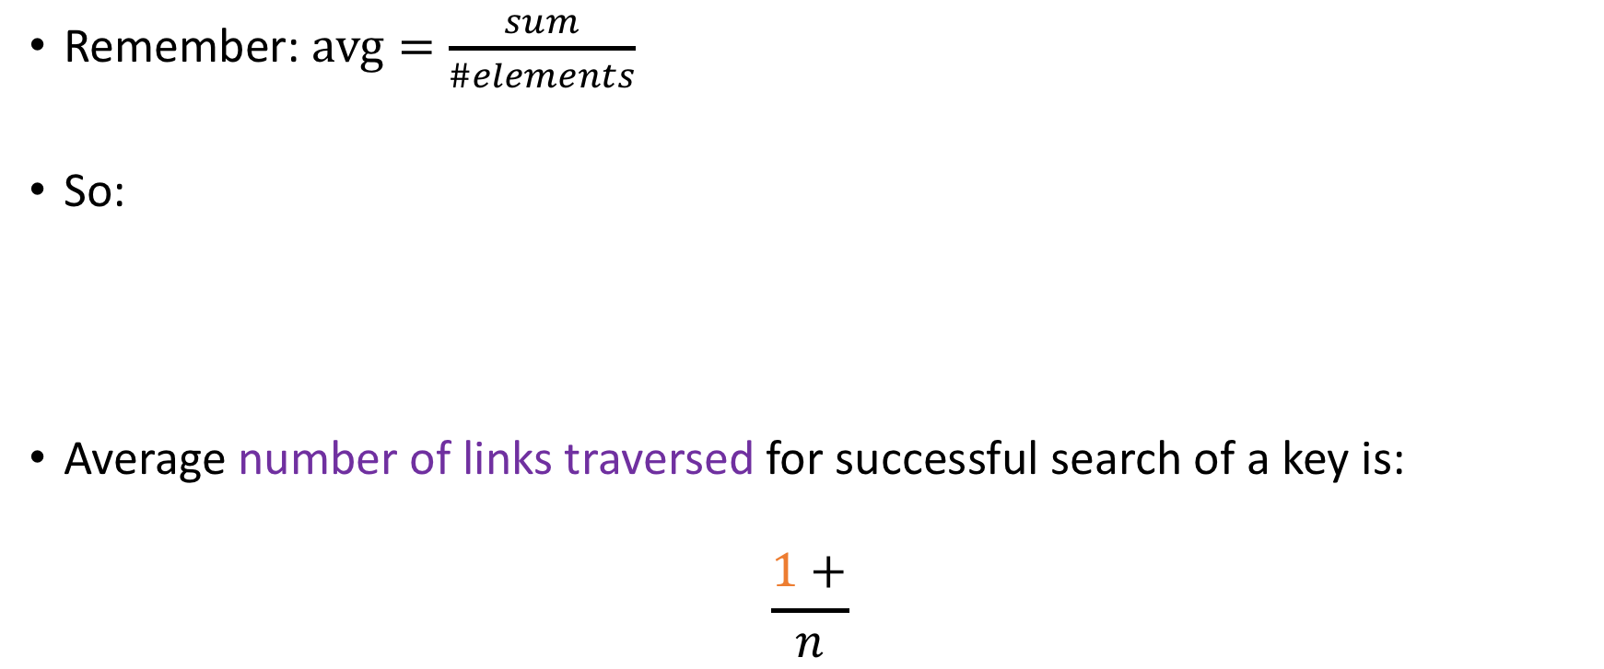
Searching a linked list
Remember: $avg=\frac{sum}{\#elements}$
So:
Average number of links traversed for successful search of a key is:
$$\frac{1+}{n}$$
ptr
G
A
X
D

Slide 53
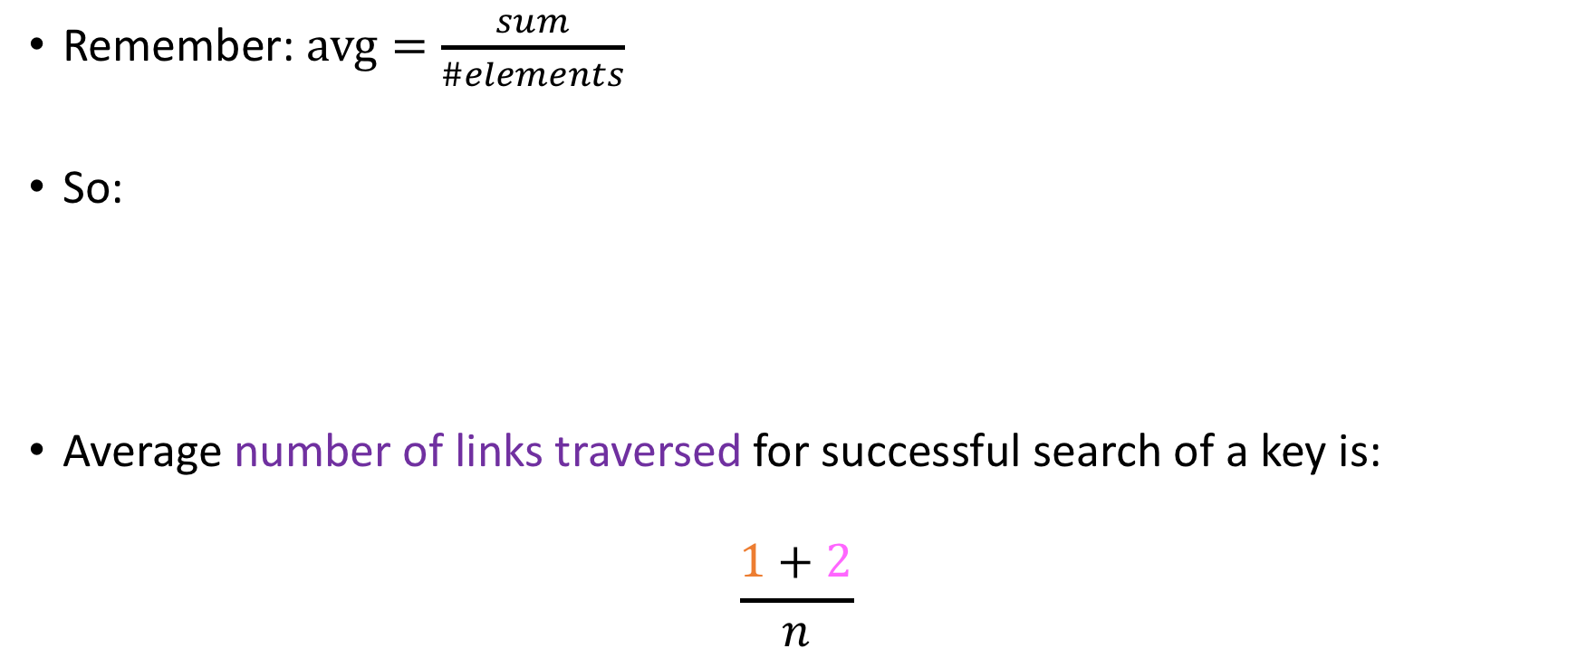
Searching a linked list
Remember: $avg=\frac{sum}{\#elements}$
So:
Average number of links traversed for successful search of a key is:
$$\frac{1+2}{n}$$
ptr
G
A
X
D

Slide 54
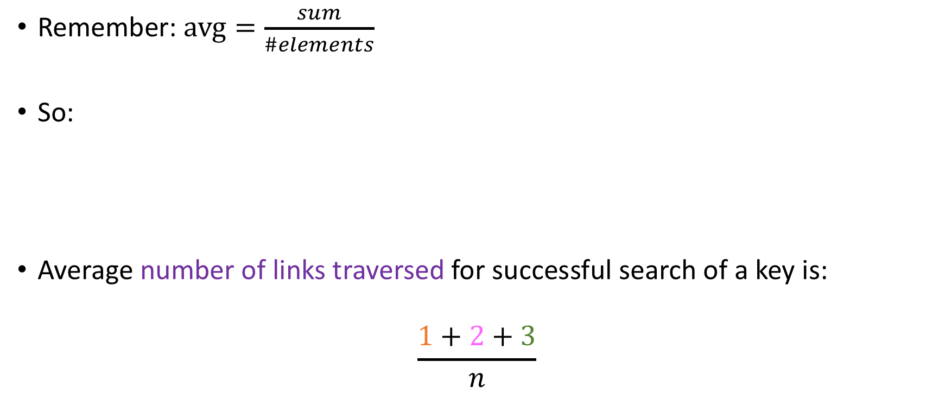
Searching a linked list
Remember: $avg=\frac{sum}{\#elements}$
So:
Average number of links traversed for successful search of a key is:
$$\frac{1+2+3}{n}$$
ptr
G
A
X
D

Slide 55
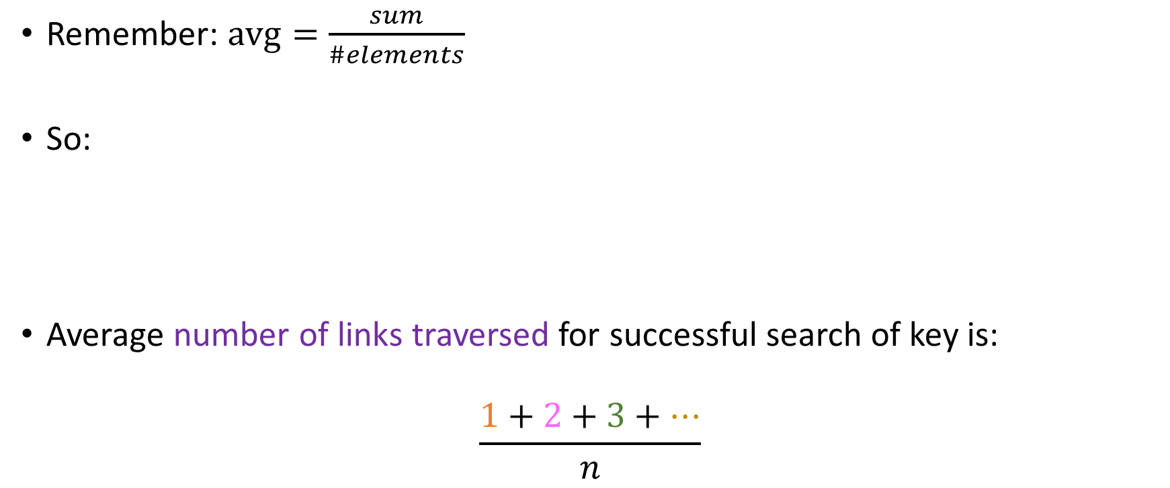
Searching a linked list
Remember: $avg=\frac{sum}{\#elements}$
So:
Average number of links traversed for successful search of key is:
$$\frac{1+2+3+…}{n}$$
ptr
G
A
X
D

Slide 56
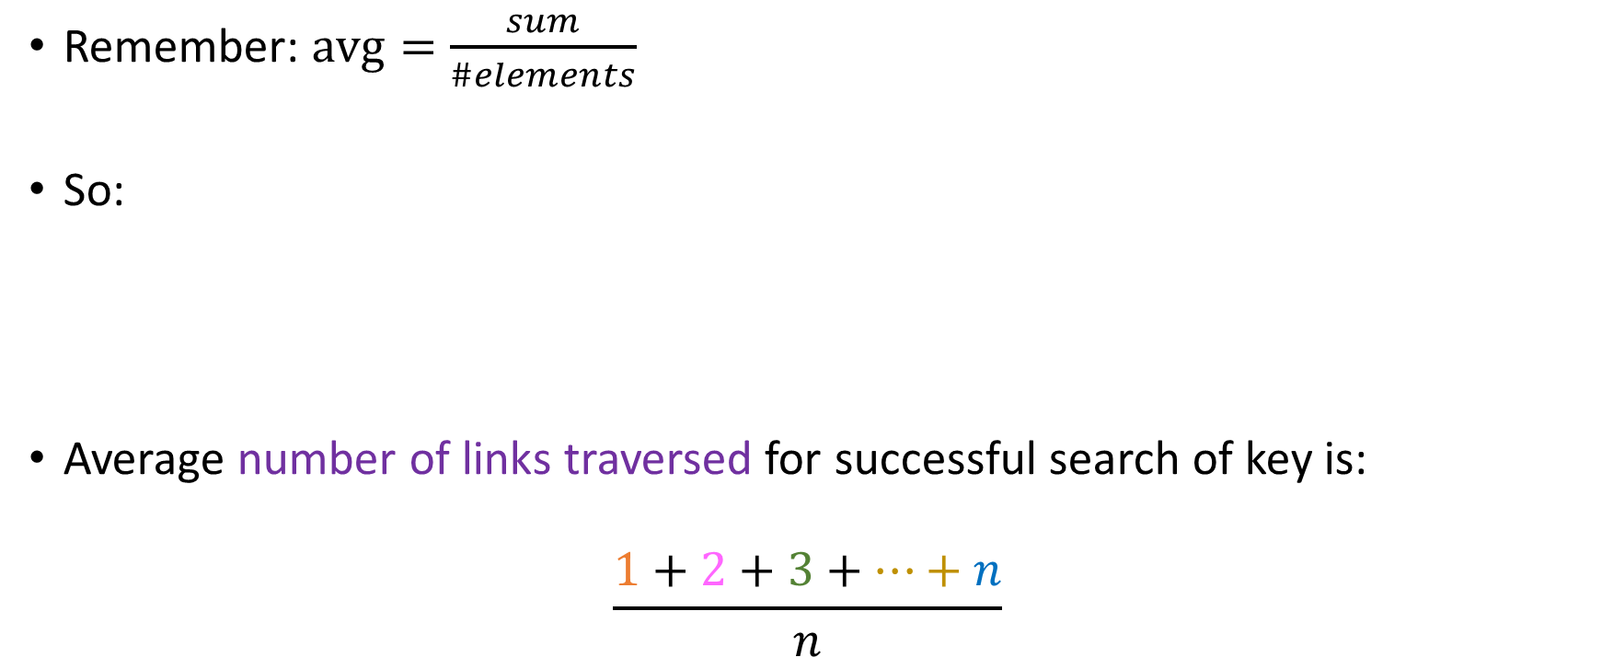
Searching a linked list
Remember: $avg=\frac{sum}{\#elements}$
So:
Average number of links traversed for successful search of key is:
$$\frac{1+2+3+…+n}{n}$$
ptr
G
A
X
D

Slide 57

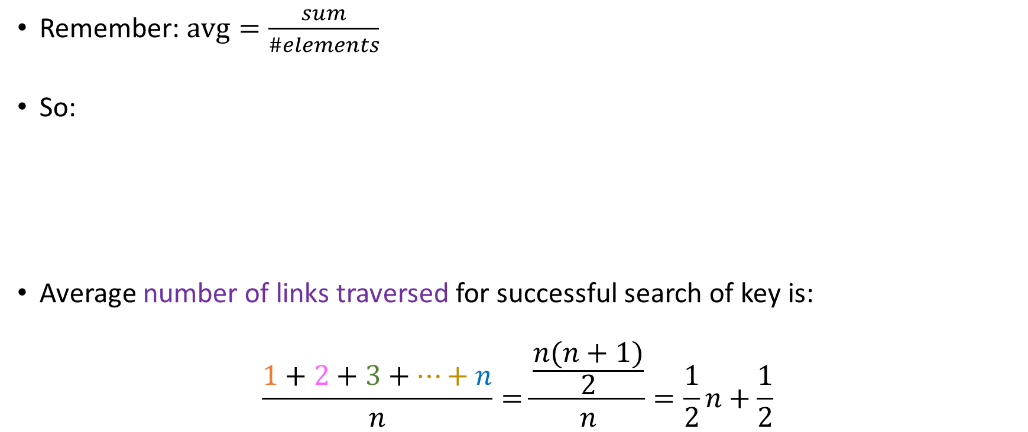
Searching a linked list
Remember: $avg=\frac{sum}{\#elements}$
So:
Average number of links traversed for successful search of key is:
$$\frac{1+2+3+…+n}{n}=\frac{\frac{n(n+1)}{2}}{n}=\frac{1}{2}n+\frac{1}{2}$$
ptr
G
A
X
D
Amortized linear!

Slide 58
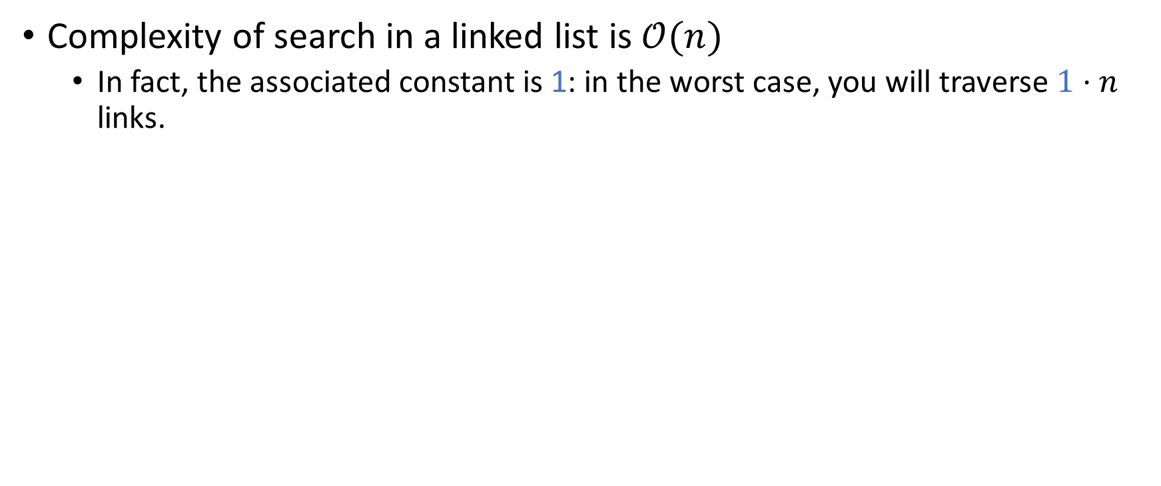
Insights from amortized analysis!
Complexity of search in a linked list is $𝒪(n)$
In fact, the associated constant is 1: in the worst case, you will traverse $1⋅n$ links.

Slide 59
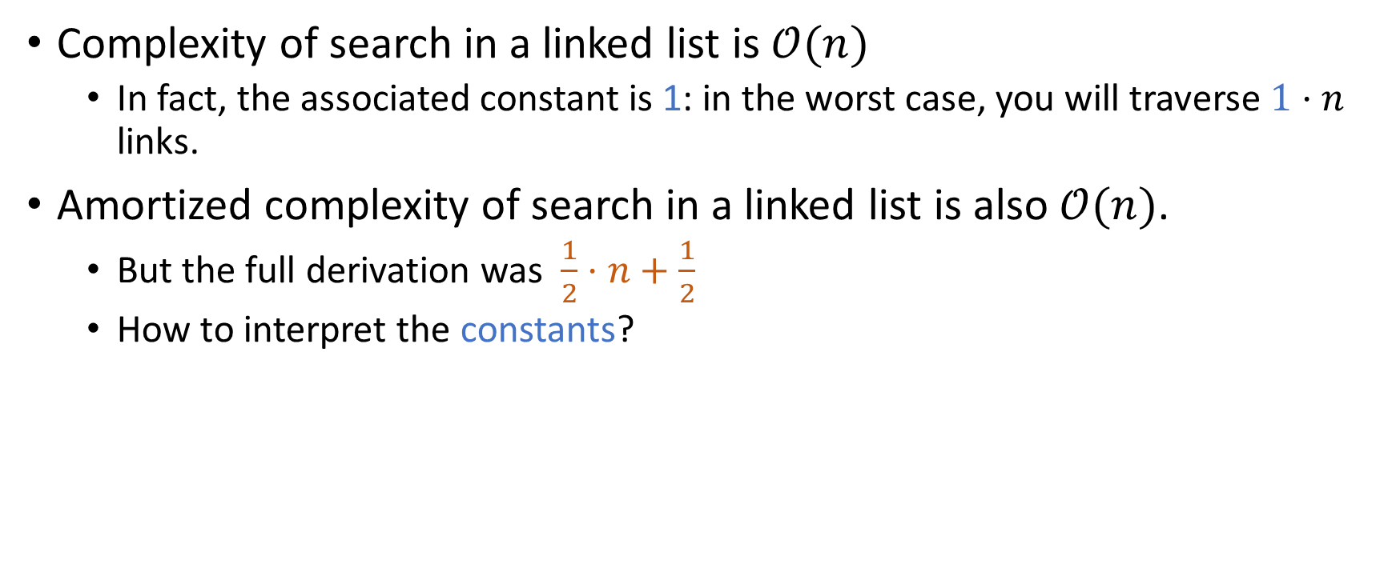
Insights from amortized analysis!
Complexity of search in a linked list is $𝒪(n)$
In fact, the associated constant is 1: in the worst case, you will traverse $1⋅n$ links.
Amortized complexity of search in a linked list is also $𝒪(n)$.
But the full derivation was $\frac{1}{2}⋅n+\frac{1}{2}$
How to interpret the constants?

Slide 60
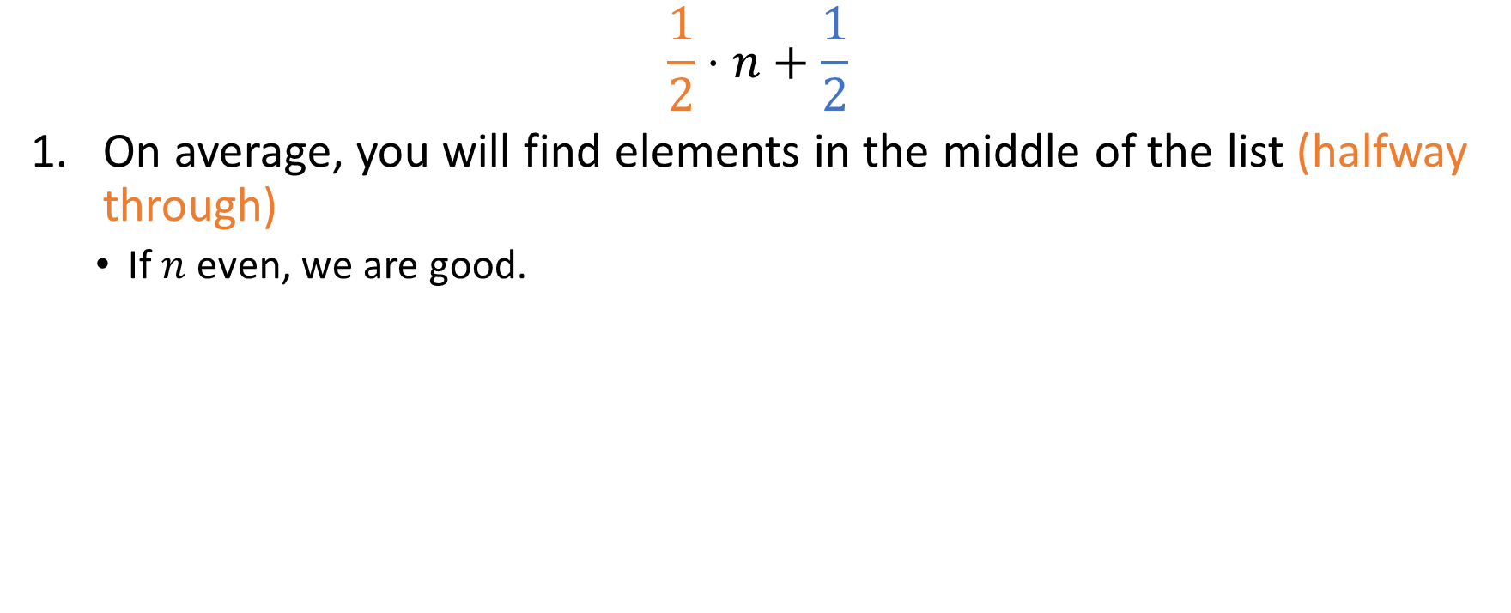
Insights from amortized analysis!
$$\frac{1}{2}⋅n+\frac{1}{2}$$
On average, you will find elements in the middle of the list (halfway through)
If $n$ even, we are good.

Slide 61

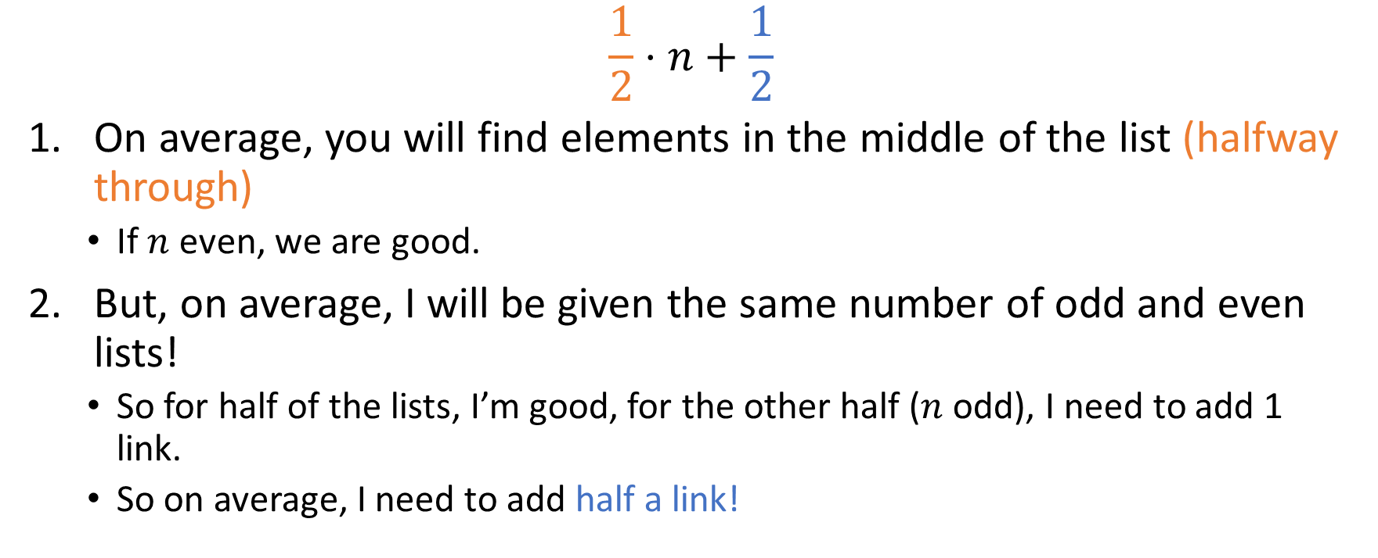
Insights from amortized analysis!
$$\frac{1}{2}⋅n+\frac{1}{2}$$
On average, you will find elements in the middle of the list (halfway through)
If $n$ even, we are good.
But, on average, I will be given the same number of odd and even lists!
So for half of the lists, I’m good, for the other half ($n$ odd), I need to add 1 link.
So on average, I need to add half a link!

Slide 62
Exercise for you
The goal: write code that traverses a threaded BST in descending order!
But! You will do this in pairs!
Student #1 writes a routine that
finds the inorder predecessor of a threaded tree
Student #2 uses that routine (must agree on
name, signature…) to write the full method!
M
A
X
x
E
x
F
G

Slide 63
(One) Solution
Node inPrec(Node n){
if(n.lb) // Inorder predecessor or NULL
return n.left;
n = n.left;
while(!n.rb)
n = n.right; // Go as far right as you can
return n;
}
void descOrderTraversal(ThreadedTree t){
Node n = t.root;
while(n.right != null)
n = n.right; // Go rightmost
print(n.value);
while(n.left != null){
n = inPrec(n);
print( (n == NULL) ? NULL : n.value);
}
M
A
X
x
E
x
F
G

Slide 64
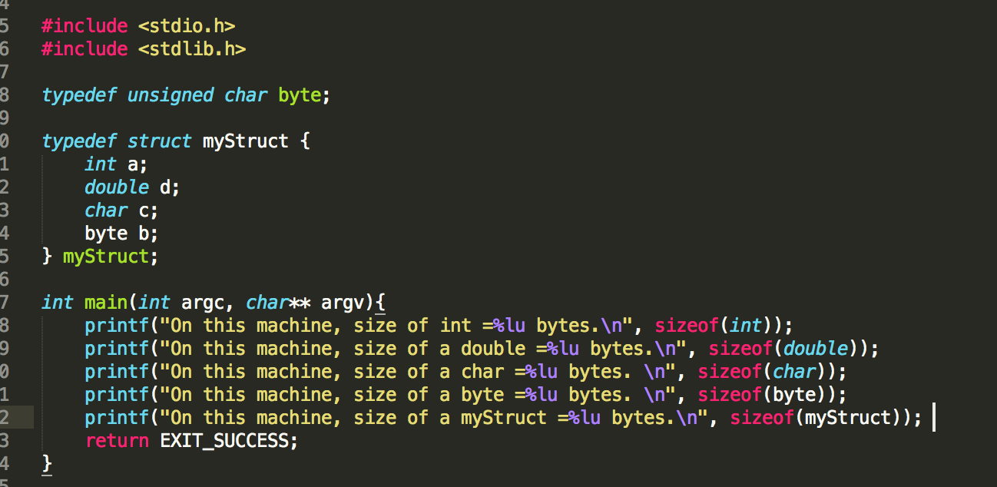



Short break – Memory alignment
What will the output of the last line of this C program be (64-bit OS)?
$$13$$
$$17$$
$$24$$
Something else (what?)

Slide 65
Short break – Memory alignment
What will the output of the last line of this C program be (64-bit OS)?
$$13$$
$$17$$
$$24$$
Something else (what?)
Memory alignment at word length (8 bytes for a 64-bit machine!)

Slide 66
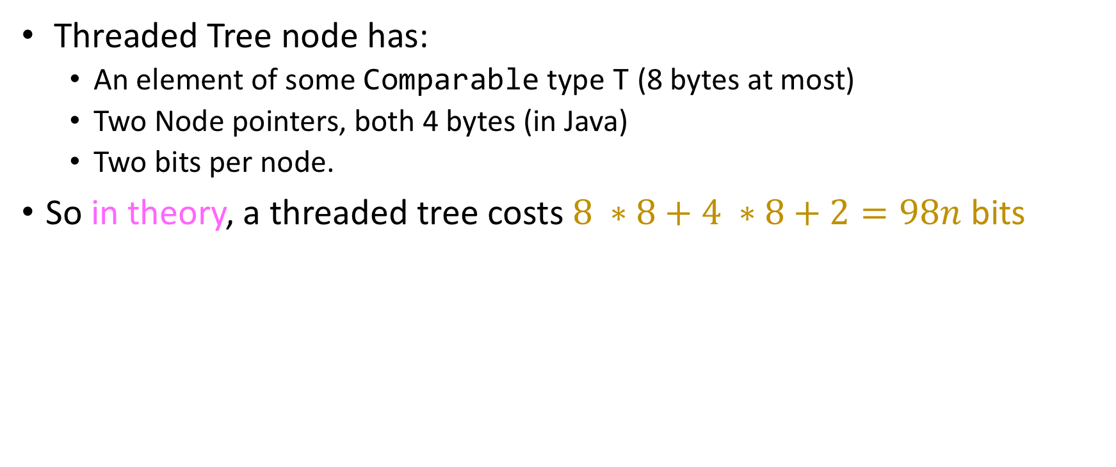
Memory footprint (in theory!)
Threaded Tree node has:
An element of some Comparable type T (8 bytes at most)
Two Node pointers, both 4 bytes (in Java)
Two bits per node.
So in theory, a threaded tree costs $8 ∗8+4 ∗8+2=98n$ bits

Slide 67
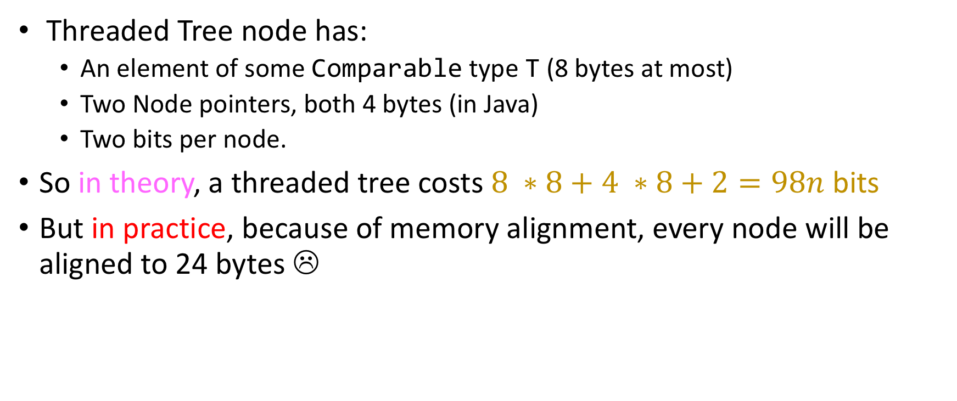
Memory footprint (in practice!)
Threaded Tree node has:
An element of some Comparable type T (8 bytes at most)
Two Node pointers, both 4 bytes (in Java)
Two bits per node.
So in theory, a threaded tree costs $8 ∗8+4 ∗8+2=98n$ bits
But in practice, because of memory alignment, every node will be aligned to 24 bytes ☹
class ThreadedNode{
T element; // 8 bytes, padded or allocated to variable
ThreadedNode left, right // exactly 8 bytes for both;
byte leftFlag, rightFlag; // 2 bytes + 6 for the padding = 8 total
}

Slide 68
Memory footprint (in practice!)
Threaded Tree node has:
An element of some Comparable type T (8 bytes at most)
Two Node pointers, both 4 bytes (in Java)
Two bits per node.
So in theory, a threaded tree costs $8 ∗8+4 ∗8+2=98n$ bits
But in practice, because of memory alignment, every node will be aligned to 24 bytes ☹
class ThreadedNode{
T element; // 8 bytes, padded or allocated to variable
ThreadedNode left, right // exactly 8 bytes for both;
byte leftFlag, rightFlag; // 2 bytes + 6 for the padding = 8 total
}
Total size in practice: $192n$ bits (barely under double!)

Slide 69
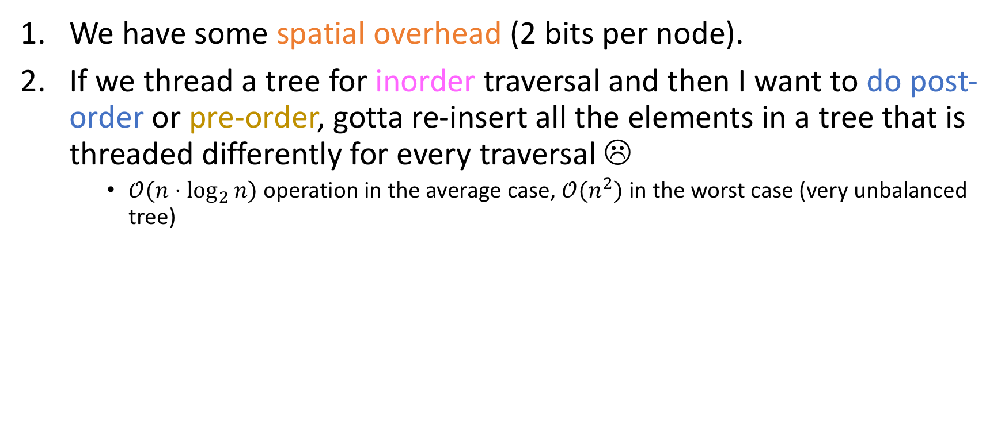
Issues with threaded trees
We have some spatial overhead (2 bits per node).
If we thread a tree for inorder traversal and then I want to do post-order or pre-order, gotta re-insert all the elements in a tree that is threaded differently for every traversal ☹
$𝒪(n⋅\log_{2}{n)}$ operation in the average case, $𝒪(n^{2})$ in the worst case (very unbalanced tree)

Slide 70
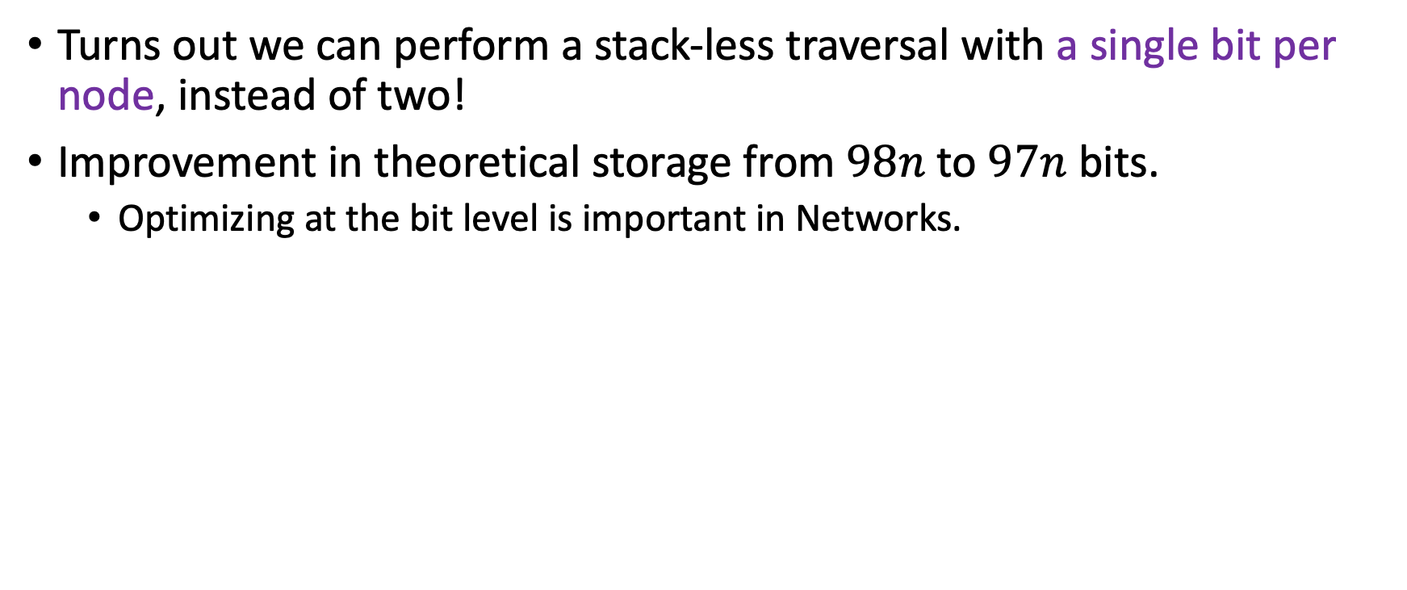
Link Inversion
Turns out we can perform a stack-less traversal with a single bit per node, instead of two!
Improvement in theoretical storage from $98n$ to $97n$ bits.
Optimizing at the bit level is important in Networks.

Slide 71
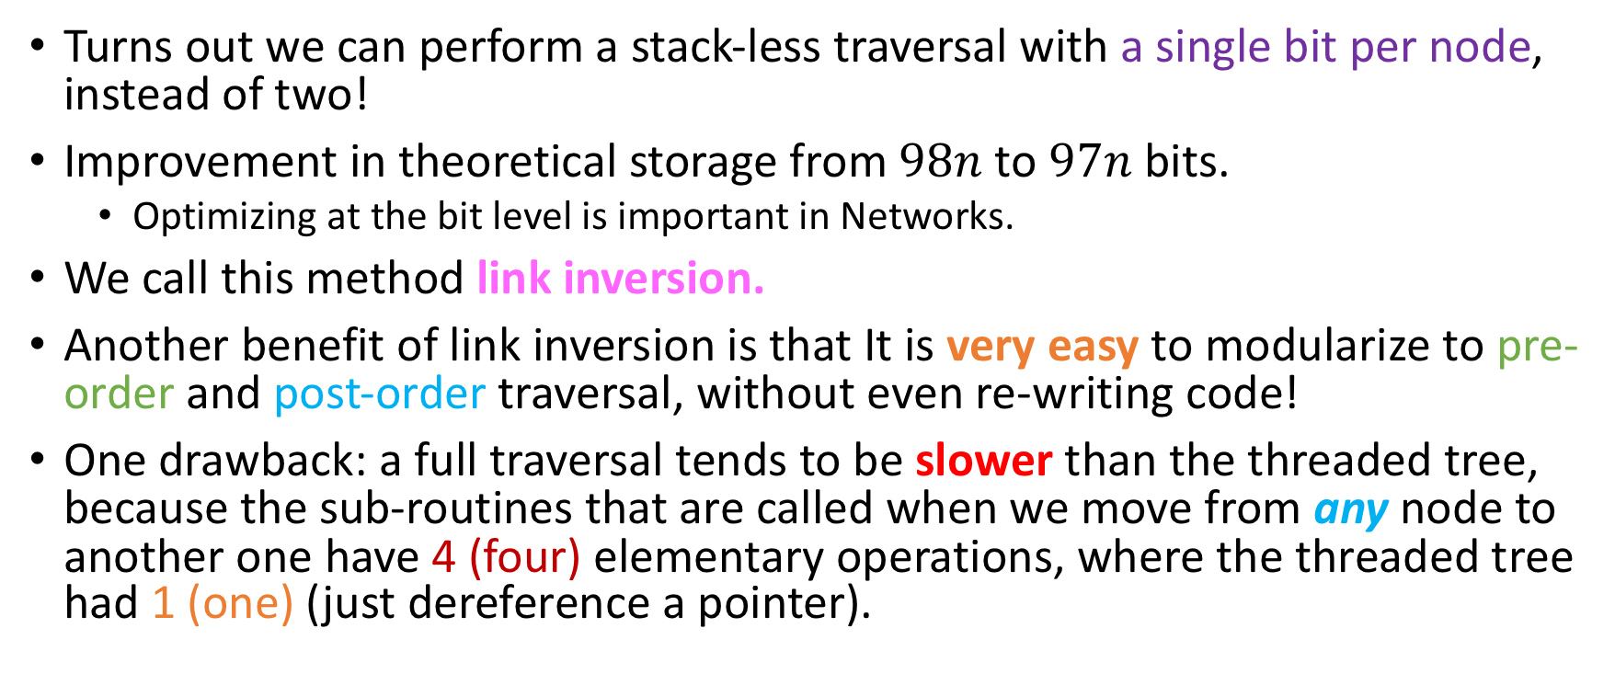
Link Inversion
Turns out we can perform a stack-less traversal with a single bit per node, instead of two!
Improvement in theoretical storage from $98n$ to $97n$ bits.
Optimizing at the bit level is important in Networks.
We call this method link inversion.
Another benefit of link inversion is that It is very easy to modularize to pre-order and post-order traversal, without even re-writing code!
One drawback: a full traversal tends to be slower than the threaded tree, because the sub-routines that are called when we move from any node to another one have 4 (four) elementary operations, where the threaded tree had 1 (one) (just dereference a pointer).

Slide 72

Question
Remember the “recursive list count” demo?

Slide 73
Recursive List Demo
We all agree that iterative is clearly the most natural and the best method to get the count.
The other two ones seem kind of stupid, honestly
We will now talk about another stupid method to traverse this list, with some interesting properties when generalized to trees.

Slide 74
Link inversion for lists
This method does not use a stack.

Slide 75
Link inversion for lists
This method does not use a stack.
It uses two pointers, prev and curr.

Slide 76
Link inversion for lists
This method does not use a stack.
It uses two pointers, prev and curr.
head
X
X
prev
curr

Slide 77
Link inversion for lists
This method does not use a stack.
It uses two pointers, prev and curr.
head
X
X
prev
curr

Slide 78
Link inversion for lists
This method does not use a stack.
It uses two pointers, prev and curr.
head
X
X
Write down a piece of Java code that achieves this!
prev
curr

Slide 79
Link inversion for lists
This method does not use a stack.
It uses two pointers, prev and curr.
head
X
X
prev
curr
Node temp = curr; curr = curr.next;
temp.next = prev;
prev = temp;

Slide 80
Link inversion for lists
This method does not use a stack.
It uses two pointers, prev and curr.
head
X
X
prev
curr
Node temp = curr; curr = curr.next;
temp.next = prev;
prev = temp;
Every one of these assignments takes about one nanosecond to finish nowadays.

Slide 81
Link inversion for lists
This method does not use a stack.
It uses two pointers, prev and curr.
head
X
X
curr
while(… ? …){
prev
Node temp = curr; curr = curr.next;
temp.next = prev; prev = temp;
}

Slide 82
Link inversion for lists
This method does not use a stack.
It uses two pointers, prev and curr.
head
X
X
while(… ? …){
prev
curr
Node temp = curr; curr = curr.next;
temp.next = prev; prev = temp;
}

Slide 83
Link inversion for lists
This method does not use a stack.
It uses two pointers, prev and curr.
curr
head
X
X
while(… ? …){
prev
Node temp = curr; curr = curr.next;
temp.next = prev; prev = temp;
}

Slide 84
Link inversion for lists
This method does not use a stack.
It uses two pointers, prev and curr.
curr
head
prev
X
X
while(… ? …){
Node temp = curr; curr = curr.next;
temp.next = prev; prev = temp;
}

Slide 85
Link inversion for lists
This method does not use a stack.
It uses two pointers, prev and curr.
curr
prev
head
X
X
while(… ? …){
Node temp = curr; curr = curr.next;
temp.next = prev; prev = temp;
}

Slide 86
Link inversion for lists
This method does not use a stack.
It uses two pointers, prev and curr.
curr
prev
head
X
X
while(… ? …){
Node temp = curr; curr = curr.next;
temp.next = prev; prev = temp;
}

Slide 87
Link inversion for lists
This method does not use a stack.
It uses two pointers, prev and curr.
curr
prev
head
X
X
while(… ? …){
Node temp = curr; curr = curr.next;
temp.next = prev; prev = temp;
}

Slide 88
Link inversion for lists
This method does not use a stack.
It uses two pointers, prev and curr.
curr
prev
head
X
X
while(… ? …){
Node temp = curr; curr = curr.next;
temp.next = prev; prev = temp;
}

Slide 89
Link inversion for lists
This method does not use a stack.
It uses two pointers, prev and curr.
curr
prev
head
X
X
while(curr!=null){
Node temp = curr; curr = curr.next;
temp.next = prev; prev = temp;
To avoid a NullPointerException…
}

Slide 90

Link inversion for lists
The method uses two pointers, prev and curr.
curr
prev
head
X
X
Clearly we can’t leave the list like this….

Slide 91
Link inversion for lists
The method uses two pointers, prev and curr.
curr
prev
head
X
X
Write down a piece of Java code that helps us backtrack one node!

Slide 92
Link inversion for lists
The method uses two pointers, prev and curr.
curr
prev
head
X
X
Node temp = prev; prev = prev.next;
temp.next = curr; curr = temp;

Slide 93
Link inversion for lists
The method uses two pointers, prev and curr.
curr
prev
head
X
X
Going forward one node
Going back one node
Node temp = prev; prev = prev.next;
temp.next = curr; curr = temp;
Node temp = curr; curr = curr.next;
temp.next = prev; prev = temp;

Slide 94
Link inversion for lists
The method uses two pointers, prev and curr.
prev
curr
head
X
X
while(… ? …){
Node temp = prev; prev = prev.next;
temp.next = curr; curr = temp;
}

Slide 95
Link inversion for lists
The method uses two pointers, prev and curr.
prev
curr
head
X
X
while(… ? …){
Node temp = prev; prev = prev.next;
temp.next = curr; curr = temp;
}

Slide 96
Link inversion for lists
The method uses two pointers, prev and curr.
prev
curr
head
X
X
while(… ? …){
Node temp = prev; prev = prev.next;
temp.next = curr; curr = temp;
}

Slide 97
Link inversion for lists
The method uses two pointers, prev and curr.
prev
curr
head
X
X
while(… ? …){
Node temp = prev; prev = prev.next;
temp.next = curr; curr = temp;
}

Slide 98
Link inversion for lists
The method uses two pointers, prev and curr.
prev
curr
head
X
X
while(… ? …){
Node temp = prev; prev = prev.next;
temp.next = curr; curr = temp;
}

Slide 99
Link inversion for lists
The method uses two pointers, prev and curr.
prev
curr
head
X
X
while(… ? …){
Node temp = prev; prev = prev.next;
temp.next = curr; curr = temp;
}

Slide 100
Link inversion for lists
The method uses two pointers, prev and curr.
head
X
X
while(… ? …){
curr
Node temp = prev; prev = prev.next;
temp.next = curr; curr = temp;
prev
}

Slide 101
Link inversion for lists
The method uses two pointers, prev and curr.
head
X
X
while(… ? …){
Node temp = prev; prev = prev.next;
temp.next = curr; curr = temp;
curr
prev
}

Slide 102
Link inversion for lists
The method uses two pointers, prev and curr.
head
X
X
while(prev != null){
To avoid a NullPointerException…
Node temp = prev; prev = prev.next;
temp.next = curr; curr = temp;
curr
prev
}

Slide 103
Link inversion for binary trees
Now suppose I want to do the same thing in a binary tree.
In effect, let’s suppose that I want to do preorder traversal in a binary tree using the method of link inversion.
Clearly, what I want to do first is go as far to the left as I can, while I print the nodes’ values.
The method will once again use two pointers: prev and curr.

Slide 104
Link inversion for binary tree preorder traversal
prev
X
curr
X
X
X
X
X
X
X
X
X

Slide 105
Link inversion for binary tree preorder traversal
prev
X
curr
Write a Java code snippet that attains this move!
curr
prev
X
X
X
X
X
X
X
X
X

Slide 106
Link inversion for binary tree preorder traversal
prev
X
curr
Node temp = curr;
curr = curr.left;
temp.left = prev;
prev = temp;
curr
prev
X
X
X
X
X
X
X
X
X

Slide 107
Link inversion for binary tree preorder traversal
prev
X
curr
Node temp = curr;
curr = curr.left;
temp.left = prev;
prev = temp;
curr
prev
X
descendLeft routine!
X
X
X
X
X
X
X
X

Slide 108
Link inversion for binary tree preorder traversal
X
while(… ? …){
Node temp = curr;
curr = curr.left;
temp.left = prev;
prev = temp;
prev
curr
}
descendLeft routine!
X
X
X
X
X
X
X
X
X

Slide 109
Link inversion for binary tree preorder traversal
X
while(… ? …){
Node temp = curr;
curr = curr.left;
temp.left = prev;
prev = temp;
}
descendLeft routine!
prev
X
curr
X
X
X
X
X
X
X
X

Slide 110
Link inversion for binary tree preorder traversal
X
while(… ? …){
Node temp = curr;
curr = curr.left;
temp.left = prev;
prev = temp;
}
descendLeft routine!
X
prev
X
X
curr
X
X
X
X
X
X

Slide 111
Link inversion for binary tree preorder traversal
X
while(curr!=null){
Node temp = curr;
curr = curr.left;
temp.left = prev;
prev = temp;
}
descendLeft routine!
X
prev
X
X
curr
X
X
X
X
X
X

Slide 112
Link inversion for binary tree preorder traversal
X
while(… ? …){
Node temp = curr;
curr = curr.left;
temp.left = prev;
prev = temp;
}
descendLeft routine!
X
prev
X
X
curr
X
X
Now we have to ascend from the left!
Same deal, write Java code that does this.
X
X
X
X

Slide 113
Link inversion for binary tree preorder traversal
X
while(… ? …){
Node temp = curr;
curr = curr.left;
temp.left = prev;
prev = temp;
}
descendLeft routine!
X
prev
X
X
curr
X
X
Node temp = prev;
prev = prev.left;
temp.left = curr;
curr=temp;
X
X
X
X

Slide 114
Link inversion for binary tree preorder traversal
X
while(… ? …){
Node temp = curr;
curr = curr.left;
temp.left = prev;
prev = temp;
ascendFromLeft routine!
}
X
descendLeft routine!
prev
X
X
curr
X
X
Node temp = prev;
prev = prev.left;
temp.left = curr;
curr=temp;
X
X
X
X

Slide 115
Link inversion for binary tree preorder traversal
X
while(… ? …){
Node temp = curr;
curr = curr.left;
temp.left = prev;
prev = temp;
ascendFromLeft routine!
}
X
descendLeft routine!
prev
X
X
curr
X
X
Node temp = prev;
prev = prev.left;
temp.left = curr;
curr=temp;
X
X
X
X

Slide 116

Link inversion for binary tree preorder traversal
X
while(… ? …){
Node temp = curr;
curr = curr.left;
temp.left = prev;
prev = temp;
ascendFromLeft routine!
}
descendLeft routine!
X
prev
X
X
curr
X
X
Node temp = prev;
prev = prev.left;
temp.left = curr;
curr=temp;
Did you notice a small issue, perhaps?
X
X
X
X

Slide 117

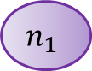
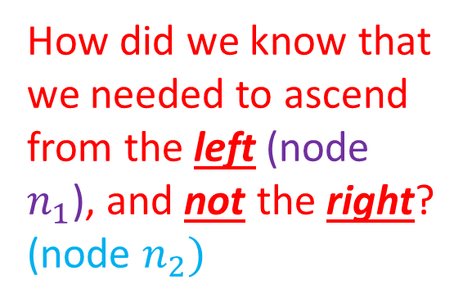
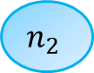
Link inversion for binary tree preorder traversal
X
while(… ? …){
Node temp = curr;
curr = curr.left;
temp.left = prev;
prev = temp;
ascendFromLeft routine!
}
X
descendLeft routine!
prev
X
X
curr
$$n_{1}$$
$$n_{2}$$
X
X
Node temp = prev;
prev = prev.left;
temp.left = curr;
curr=temp;
How did we know that we needed to ascend from the left (node $n_{1}$), and not the right? (node $n_{2})$
X
X
X
X

Slide 118
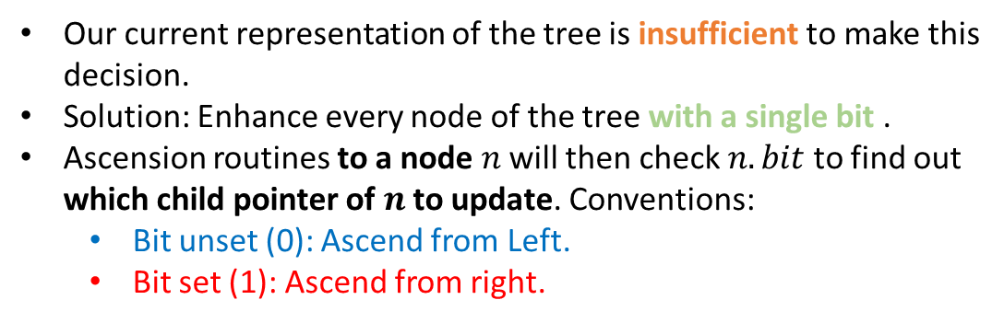
We didn’t.
X
X
X
X
X
X
Our current representation of the tree is insufficient to make this decision.
Solution: Enhance every node of the tree with a single bit .
Ascension routines to a node $n$ will then check $n.bit$ to find out which child pointer of $n$ to update. Conventions:
Bit unset (0): Ascend from Left.
Bit set (1): Ascend from right.
X
X
X
X

Slide 119
We didn’t.
X
X
X
X
X
X
Our current representation of the tree is insufficient to make this decision.
Solution: Enhance every node of the tree with a single bit .
Ascension routines to a node $n$ will then check $n.bit$ to find out which child pointer of $n$ to update. Conventions:
Bit unset (0): Ascend from Left.
Bit set (1): Ascend from right.
X
X
X
X

Slide 120
We didn’t.
X
X
prev
X
X
curr
X
X
Our current representation of the tree is insufficient to make this decision.
Solution: Enhance every node of the tree with a single bit .
Ascension routines to a node $n$ will then check $n.bit$ to find out which child pointer of $n$ to update. Conventions:
Bit unset (0): Ascend from Left.
Bit set (1): Ascend from right.
X
X
X
X

Slide 121
But now we do!
Now we know that we ascend from the left, so we need to change the left pointer of this node!
X
void ascendFromLeft(){
Node temp = prev;
prev = prev.left;
temp.left = curr;
curr=temp; }
X
prev
X
X
curr
X
X
Our current representation of the tree is insufficient to make this decision.
Solution: Enhance every node of the tree with a single bit .
Ascension routines to a node $n$ will then check $n.bit$ to find out which child pointer of $n$ to update. Conventions:
Bit unset (0): Ascend from Left.
Bit set (1): Ascend from right.
X
X
X
X

Slide 122
But now we do!
X
void ascendFromLeft(){
Node temp = prev;
prev = prev.left;
temp.left = curr;
curr=temp; }
prev
X
curr
X
X
X
X
Our current representation of the tree is insufficient to make this decision.
Solution: Enhance every node of the tree with a single bit .
Ascension routines to a node $n$ will then check $n.bit$ to find out which child pointer of $n$ to update. Conventions:
Bit unset (0): Ascend from Left.
Bit set (1): Ascend from right.
X
X
X
X

Slide 123

But now we do!
X
void ascendFromLeft(){
Node temp = prev;
prev = prev.left;
temp.left = curr;
curr=temp; }
prev
X
curr
X
X
X
X
Our current representation of the tree is insufficient to make this decision.
Solution: Enhance every node of the tree with a single bit .
Ascension routines to a node $n$ will then check $n.bit$ to find out which child pointer of $n$ to update. Conventions:
Bit unset (0): Ascend from Left.
Bit set (1): Ascend from right.
X
X
X
X
But don’t forget this is preorder traversal! So we need to descend right!

Slide 124
Descending right…
X
X
prev
X
X
X
X
descendRight() is entirely symmetrical to descendLeft().
X
X
X
X
curr

Slide 125
And ascending from right!
X
prev
X
curr
X
X
X
X
descendRight() is entirely symmetrical to descendLeft().
ascendFromRight() is entirely symmetrical to ascendFromLeft()!
X
X
X
X

Slide 126
Traversal…
Routine used: ascendFromleft()
X
prev
curr
X
X
X
X
X
X
X
X
X

Slide 127
Traversal…
Routine used: descendRight()
X
prev
X
X
X
X
X
X
X
X
X
curr

Slide 128
Traversal…
Routine used: descendLeft()
X
X
X
X
X
X
prev
X
X
X
X
curr

Slide 129
Traversal…
Routine used: ascendFromleft()
X
prev
X
curr
X
X
X
X
X
X
X
X

Slide 130
Traversal…
Routine used: descendRight()
X
X
prev
X
X
X
X
X
X
X
X
curr

Slide 131
Traversal…
Routine used: ascendFromRight()
X
prev
X
curr
X
X
X
X
X
X
X
X

Slide 132
Traversal…
Routine used: ascendFromRight()
X
prev
curr
X
X
X
X
X
X
X
X
X

Slide 133
Traversal…
Routine used: ascendFromLeft()
X
prev
curr
X
X
X
X
X
X
X
X
X

Slide 134
Traversal…
Routine used: descendRight()
X
prev
curr
X
X
X
X
X
X
X
X
X

Slide 135
Traversal…
Routine used: descendLeft()
X
prev
X
curr
X
X
X
X
X
X
X
X

Slide 136
Traversal…
Routine used: ascendFromLeft()
X
prev
curr
X
X
X
X
X
X
X
X
X

Slide 137
Traversal…
Routine used: descendRight()
X
prev
X
X
X
X
X
curr
X
X
X
X

Slide 138
Traversal…
Routine used: ascendFromRight()
X
prev
curr
X
X
X
X
X
X
X
X
X

Slide 139
Traversal…
Routine used: ascendFromRight()
prev
X
curr
X
X
X
X
X
X
X
X
X

Slide 140
Traversal…
Routine used: ascendFromLeft()
X
curr
prev
X
X
X
X
X
X
X
X
X

Slide 141
Traversal…
Routine used: descendRight()
X
prev
curr
X
X
X
X
X
X
X
X
X

Slide 142
Traversal…
Routine used: descendLeft()
X
prev
curr
X
X
X
X
X
X
X
X
X

Slide 143
Traversal…
Routine used: ascendFromleft()
prev
X
curr
X
X
X
X
X
X
X
X
X

Slide 144
Traversal…
Routine used: descendRight()
X
prev
curr
X
X
X
X
X
X
X
X
X

Slide 145
Traversal…
Routine used: descendLeft()
X
prev
X
X
X
curr
X
X
X
X
X
X

Slide 146
Traversal…
Routine used: ascendFromleft()
X
prev
curr
X
X
X
X
X
X
X
X
X

Slide 147
Traversal…
Routine used: descendRight()
X
prev
X
X
X
curr
X
X
X
X
X
X

Slide 148
Traversal…
Routine used: ascendFromRight()
X
prev
X
curr
X
X
X
X
X
X
X
X

Slide 149
Traversal…
Routine used: ascendFromRight()
X
prev
curr
X
X
X
X
X
X
X
X
X

Slide 150
Traversal…
Routine used: ascendFromRight()
curr
prev
X
X
X
X
X
X
X
X
X
X

Slide 151
Traversal…
What’s the termination condition of Link Inversion?
curr
prev
X
prev = null
Something Else
X
X
X
X
X
X
X
X
X

Slide 152

Traversal…
What’s the termination condition of Link Inversion?
curr
prev
X
prev = null
Something Else
X
prev = null AND curr.bit = 1
X
X
X
X
prev = null was encountered before as well, when we were ascending to the root from the left!
But the blue bit was telling us that there might be an entire right subtree to explore!
And, of course, there was.
X
X
X
X

Slide 153

Fill-in the full algorithm!
descendToLeft()
void preorderLI(){
if(root == null) return;
Node curr = root, prev = null;
while(!((curr.bit == 1) && (prev ==null)){
while(curr != null){
print(curr.value);
curr.bit = 0;
descendToLeft();
}
while(prev != null && prev.bit == 1)
ascendFromRight();
if(prev == null)
return;
else {
ascendFromLeft();
curr.bit=1;
descendToRight();
}
}
}
ascendFromLeft()
(1)
descendToRight()
(2)
ascendFromRight()
(3)
(4)

Slide 154

Fill-in the full algorithm!
void preorderLI(){
if(root == null) return;
Node curr = root, prev = null;
while(!((curr.bit == 1) && (prev ==null)){
while(curr != null){
print(curr.value);
curr.bit = 0;
}
while(prev != null && prev.bit == 1)
ascendFromRight();
if(prev == null)
return;
else {
ascendFromLeft();
curr.bit=1;
descendToRight();
}
}
}
ascendFromLeft()
(1)
descendToRight()
descendToLeft()
(2)
ascendFromRight()
(3)
(4)

Slide 155

Fill-in the full algorithm!
void preorderLI(){
if(root == null) return;
Node curr = root, prev = null;
while(!((curr.bit == 1) && (prev ==null)){
while(curr != null){
print(curr.value);
curr.bit = 0;
}
while(prev != null && prev.bit == 1)
k
if(prev == null)
return;
else {
ascendFromLeft();
curr.bit=1;
descendToRight();
}
}
}
ascendFromLeft()
(1)
descendToRight()
descendToLeft()
(2)
ascendFromRight()
(3)
(4)

Slide 156

Fill-in the full algorithm!
void preorderLI(){
if(root == null) return;
Node curr = root, prev = null;
while(!((curr.bit == 1) && (prev ==null)){
while(curr != null){
print(curr.value);
curr.bit = 0;
}
while(prev != null && prev.bit == 1)
k
if(prev == null)
return;
else {
ascendFromLeft();
curr.bit=1;
descendToRight();
}
}
}
(1)
descendToLeft()
(2)
ascendFromRight()
(3)
ascendFromLeft()
(4)
descendToRight()

Slide 157
The full algorithm
void preorderLI(){
if(root == null) return;
Node curr = root, prev = null;
while(!((curr.bit == 1) && (prev ==null)){
while(curr != null){ // Descend left as far as you can.
print(curr.value); // Remember: Preorder Traversal.
curr.bit = 0;
descendToLeft();
}
while(prev != null && prev.bit == 1) // Ascend from right as far as you can.
ascendFromRight(); // There might be no ascension; that’s fine
if(prev == null) //Termination condition.
return;
else {
ascendFromLeft(); // This time, however, we are guaranteed an ascension.
curr.bit=1; // The bit is only set when you ascend to a node from the left…
descendToRight(); // … and this signals an immediate descent to the right!
}
}
}

Slide 158
The full algorithm
Now modify it to do:
Inorder Traversal
Postorder Traversal
void preorderLI(){
if(root == null) return;
Node curr = root, prev = null;
while(!((curr.bit == 1) && (prev ==null)){
while(curr != null){ // Descend left as far as you can.
print(curr.value); // Remember: Preorder Traversal.
curr.bit = 0;
descendToLeft();
}
while(prev != null && prev.bit == 1) // Ascend from right as far as you can.
ascendFromRight(); // There might be no ascension; that’s fine
if(prev == null) //Termination condition.
return;
else {
ascendFromLeft(); // This time, however, we are guaranteed an ascension.
curr.bit=1; // The bit is only set when you ascend to a node from the left…
descendToRight(); // … and this signals an immediate descent to the right!
}
}
}

Slide 159
Inorder:
Now modify it to do:
Inorder Traversal
Postorder Traversal
void preorderLI(){
if(root == null) return;
Node curr = root, prev = null;
while(!((curr.bit == 1) && (prev ==null)){
while(curr != null){ // Descend left as far as you can.
print(curr.value); // Remember: Preorder Traversal.
curr.bit = 0;
descendToLeft();
}
while(prev != null && prev.bit == 1) // Ascend from right as far as you can.
ascendFromRight(); // There might be no ascension; that’s fine
if(prev == null) //Termination condition.
return;
else {
ascendFromLeft(); // This time, however, we are guaranteed an ascension.
print(curr.value); // Remember: Inorder Traversal.
curr.bit=1; // The bit is only set when you ascend to a node from the left…
descendToRight(); // … and this signals an immediate descent to the right!
}
}
}

Slide 160
Postorder:
Now modify it to do:
Inorder Traversal
Postorder Traversal
void preorderLI(){
if(root == null) return;
Node curr = root, prev = null;
while(!((curr.bit == 1) && (prev ==null)){
while(curr != null){ // Descend left as far as you can.
print(curr.value); // Remember: Preorder Traversal.
curr.bit = 0;
descendToLeft();
}
while(prev != null && prev.bit == 1){ // Ascend from right as far as you can.
ascendFromRight(); // There might be no ascension; that’s fine
print(curr.value); // Remember: Postorder Traversal.
}
if(prev == null) //Termination condition.
return;
else {
ascendFromLeft(); // This time, however, we are guaranteed an ascension.
curr.bit=1; // The bit is only set when you ascend to a node from the left…
descendToRight(); // … and this signals an immediate descent to the right!
}
}
}

Slide 161
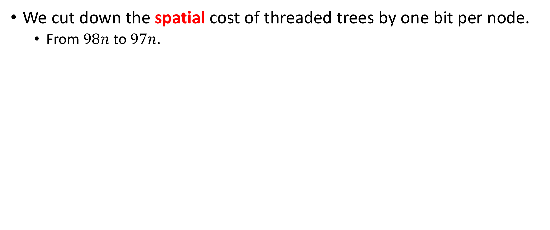
Analysis
We cut down the spatial cost of threaded trees by one bit per node.
From $98n$ to $97n$.

Slide 162
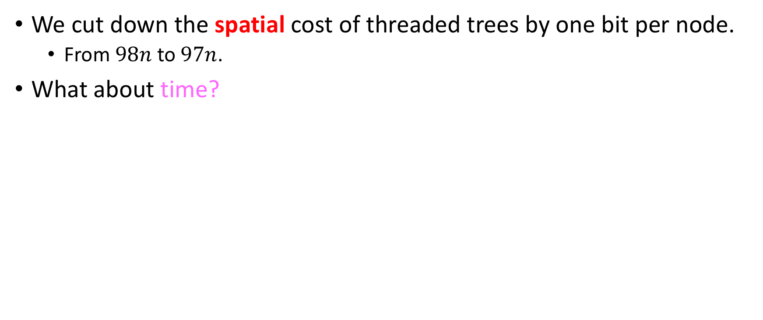
Analysis
We cut down the spatial cost of threaded trees by one bit per node.
From $98n$ to $97n$.
What about time?

Slide 163
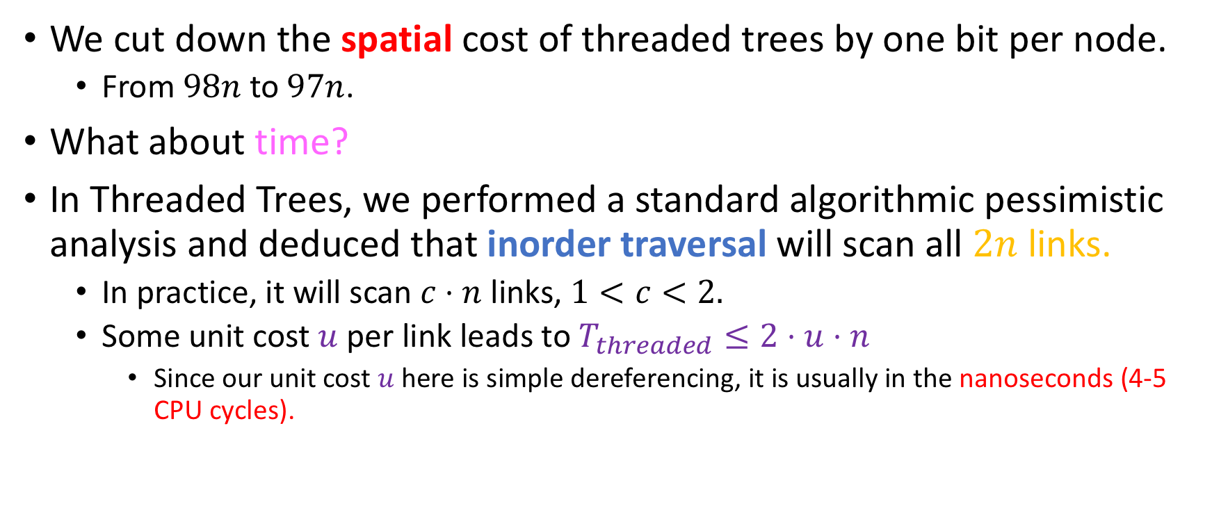
Analysis
We cut down the spatial cost of threaded trees by one bit per node.
From $98n$ to $97n$.
What about time?
In Threaded Trees, we performed a standard algorithmic pessimistic analysis and deduced that inorder traversal will scan all $2n$ links.
In practice, it will scan $c⋅n$ links, $1<c<2.$
Some unit cost $u$ per link leads to $T_{threaded}≤2⋅u⋅n$
Since our unit cost $u$here is simple dereferencing, it is usually in the nanoseconds (4-5 CPU cycles).

Slide 164
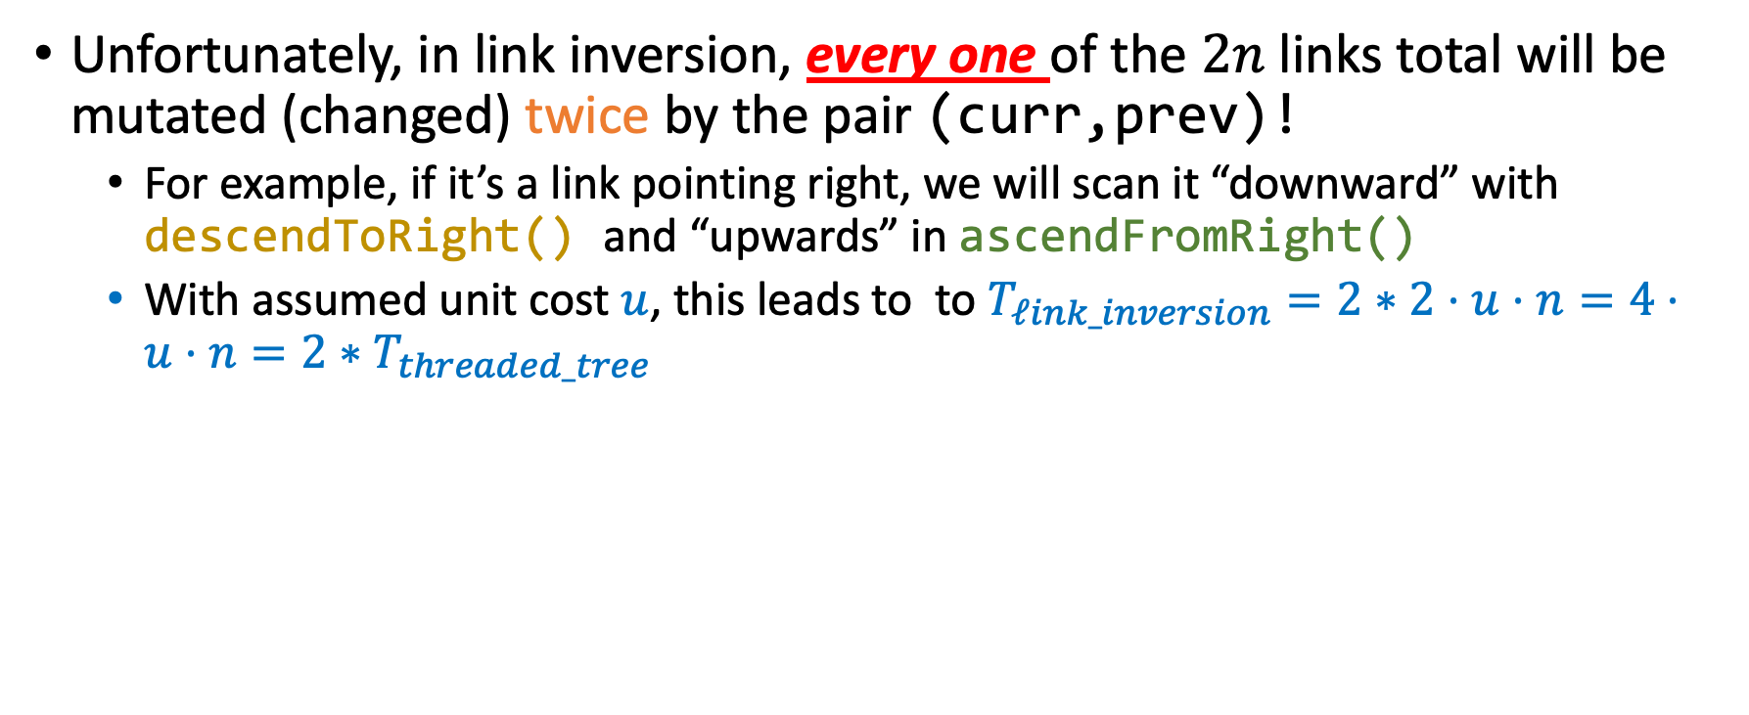
Analysis
Unfortunately, in link inversion, every one of the $2n$ links total will be mutated (changed) twice by the pair (curr,prev)!
For example, if it’s a link pointing right, we will scan it “downward” with descendToRight() and “upwards” in ascendFromRight()
With assumed unit cost $u$, this leads to to $T_{ℓink_inversion}=2∗2⋅u⋅n=4⋅u⋅n=2∗T_{threaded_tree}$

Slide 165
Analysis
Algo also mutates the tree, so it needs to restore it if the application gets interrupted.
Big benefit over threaded trees: Modularity for other traversals
Inorder: Sorted order
Pre-order: best for search and for other applications, e.g create a carbon copy of a tree.
Post-order: Used by every garbage collector out there (freeing leaves before parents).

Slide 166
Robson traversal
Runs in constant storage!
Space requirements: 5 pointers (so 40 bytes).
We will not cover it
Past honor’s project; can share student solution / presentation.
Implemented in almost all garbage collectors out there.

